Slide 1
Balancing confidentiality and data utility for dissemination of scientific use microdata
Lara Cleveland
Research Scientist
Director of International Projects
IPUMS, University of Minnesota
May 2025
Notes:
Bienvenidos al seminario web del día de hoy sobre la "Asociación con IPUMS“ para la diseminación de censos y encuestas.
Me llamo XXXX. Soy el XXX de IPUMS.
Me acompañan mis colegas, quienes se presentarán brevemente. (información breve)
Este seminario web está dirigido a representantes de los institutos nacionales de estadística para que conozcan más sobre trabajo que hacemos en IPUMS.
Les agradecemos por acompañarnos.
Si su instituto nacional de estadística ya está cooperando con IPUMS, es una gran oportunidad presentarnos a ustedes y mostrar algo de nuestro trabajo.
Si aún no son socios del proyecto, esperamos que la presentación permita conocer mejor a IPUMS y se traduzca en una colaboración futura.

Slide 2
The risk-utility balance
The 5 safes framework
Microdata protection approaches
Notes:
Esta es nuestra agenda para el día de hoy. Comenzaré con una descripción de qué es IPUMS, sobre quiénes son sus usuarios del proyecto y qué hacen con los datos.
A continuación, vamos a hacer una visita rápida al portal web para que puedan ver qué recursos están disponible para los usuarios inscritos y qué facilidades ofrece el sistema de diseminación.
Finalmente, compartiremos detalles sobre los beneficios de asociarse con IPUMS y los pasos necesarios para la cooperación entre IPUMS y sus instituciones.

Slide 3
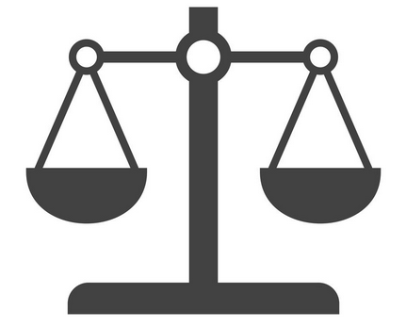
THE CURRENT DATA PROTECTION ENVIRONMENT
Huge research potential
Better planning
Make the data accessible
More and faster solution options
Data to combine “disclosive”
Protect privacy
Options are too numerous or overly complex
DATA
UTILITY
DATA
SAFETY
Data deluge
Good data stewardship
Technology

Slide 4
CONFIDENTIALIZATION
Risk
How might disclosure occur?
What might be disclosed?
Utility
Useful for what purpose?
utility
privacy
Image: www.needpix.com

Slide 5
RISK ASSESSMENT
Informal
Is this data likely to be targeted?
Does it contain any sensitive questions/responses? (e.g., ethnic minorities)
Do certain combinations of variables pose a risk (e.g., unusual occupation in a specific geographic unit)
Formal
k-anonymity, l-diversity, t-closeness
In general,
Based on detecting unique records
In practice,
Can be complicated to calculate; easily skewed by large number of responses/variables
Do not detect noise/confusion or other
Do not account for sampling
Notes:
Highly Context dependent
Can occur at different levels, at different times in the data life cycle
Can be informal or formal assessments
Informal
Is this data likely to be targeted?
Does this data contain any sensitive questions?
Sensitive responses (EG, ethnic minorities)
Do certain combinations of variables pose a risk
EG, ethnic minority in a specific geographic unit
Formal
k-anonymity, l-diversity, t-closeness Detecting unique recordshow easy it is to individuate records.
In practice, these metrics can be complicated to calculate and easily skewed by large number of responses and/or variables.
Do not detect noise/confusion or other
Does a unique record in a sample represent the same risk as a unique records in the population?
Answers to these qualitative questions will help guide which data treatment(s) are needed before releasing public use data
Highly Context dependent
Can be formal (quantitative, systematic) or informal (qualitative, selective-checking)
Qualitative
Is this data likely to be targeted?
Does this data contain any sensitive questions?
Sensitive responses (EG, ethnic minorities)
Do certain combinations of variables pose a risk
EG, ethnic minority in a specific geographic unit

Slide 6
UTILITY CONSIDERATIONS
Narrow Utility for very specific analysis
Easy for small handful of tests, does not address EVERY analysis the public might do
Useful to spot-check common cross-tabs (EG: SEX by Geog)
Broad Utility for more general use
Not trying to match a specific metric, addresses the structure of dataset as a whole
Can get complicated as many data treatments alter class of the data
Notes:
Two main types of Utility to consider but both consider the question:
“Does the treated data approximate the raw data”
If data treatments change the structure of response values, they will lower the utility of the data. If data utility is lowered too much, it may be useless.
If utility drops too much as a result of data treatment, perhaps it was the wrong way to treat the data. Consider using different parameters or a different data treatment method

Slide 7
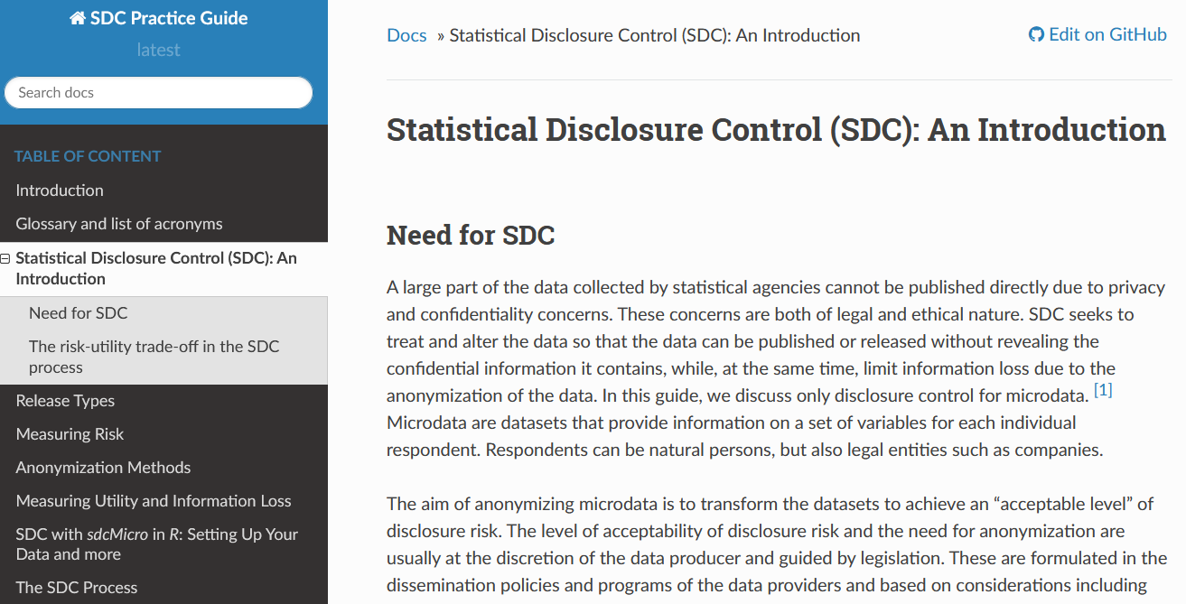
RISK ASSESSMENT TOOL
SDC Micro
Risk assessment tool
https://sdcpractice.readthedocs.io/en/latest/SDC_intro.html https://www.jstatsoft.org/article/view/v067i04
https://www.ihsn.org/software/disclosure-control-toolbox https://centre.humdata.org/learning-path/disclosure-risk-assessment-overview/statistical-disclosure-control-tutorial/
Notes:
Answers to these qualitative questions will help guide which data treatment(s) are needed before releasing public use data
Highly Context dependent
Can be formal (quantitative, systematic) or informal (qualitative, selective-checking)
Quantitative
k-anonymity, l-diversity, t-closeness; in general:
Identify variables that might be identifiers (quasi-identifiers)
Determine a level of individuation (unique records) based on these variables
Consider if/how unique characteristics relate to sensitive information
In practice, can be extremely difficult and time consuming to calculate these metrics, but you can employ these ideas qualitatively
These metrics SPECIFICALLY measure individuation and covarition, they DO NOT TAKE INTO ACCOUNT or DETECT effects of noise, confidence, etc

Slide 8
The risk-utility balance
The 5 safes framework
Microdata protection approaches
Notes:
Esta es nuestra agenda para el día de hoy. Comenzaré con una descripción de qué es IPUMS, sobre quiénes son sus usuarios del proyecto y qué hacen con los datos.
A continuación, vamos a hacer una visita rápida al portal web para que puedan ver qué recursos están disponible para los usuarios inscritos y qué facilidades ofrece el sistema de diseminación.
Finalmente, compartiremos detalles sobre los beneficios de asociarse con IPUMS y los pasos necesarios para la cooperación entre IPUMS y sus instituciones.

Slide 9
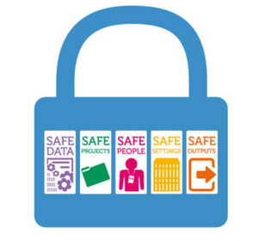
CHALLENGES: DATA PROTECTION
Safe projects
Safe people
Safe data
Safe settings
Safe output
Is this use of the data appropriate, lawful, ethical and sensible?
FIVE SAFES FRAMEWORK
Can the user be trusted to use data in an appropriate manner?
Does the data itself contain sufficient information for a potential confidentiality breach?
Does the access facility limit unauthorized use or mistakes?
Is the confidentiality maintained for the outputs by the data management system?
https://blog.ons.gov.uk/2017/01/27/the-five-safes-data-privacy-at-ons/
https://www.abs.gov.au/about/data-services/data-confidentiality-guide/five-safes-framework

Slide 10
CHALLENGES: DATA PROTECTION
DATA
SAFETY
DATA
UTILITY
FIVE SAFES FRAMEWORK
Projects – People – Data – Settings – Output
Teaching (toy) data
Highly treated
Limited detail
No identifiers
Fully public
Safe, low utility
or even erroneous
Extra safe data
Scientific use files
(e.g., IPUMS, MICS, DHS) Sampled & lightly treated
Some detail omitted
No identifiers
Screen & vet users
Good analytical power, some usage barriers
Sandard confidentiality User registration/review
Restricted access center
Little or no infused error
Lots of detail & full files
May have identifiers
Detailed user application
Great analytical power, limited usage, costly
Safe people & setting
Tabulators/platforms
(REDATAM, StatCompiler)
Constrained flexibility
Controlled detail
For predictable outputs
Public or internal users
Retain controlled detail,
limited flexibility
Highly controlled output

Slide 11
The risk-utility balance
The 5 safes framework
Microdata protection approaches
Notes:
Esta es nuestra agenda para el día de hoy. Comenzaré con una descripción de qué es IPUMS, sobre quiénes son sus usuarios del proyecto y qué hacen con los datos.
A continuación, vamos a hacer una visita rápida al portal web para que puedan ver qué recursos están disponible para los usuarios inscritos y qué facilidades ofrece el sistema de diseminación.
Finalmente, compartiremos detalles sobre los beneficios de asociarse con IPUMS y los pasos necesarios para la cooperación entre IPUMS y sus instituciones.

Slide 12
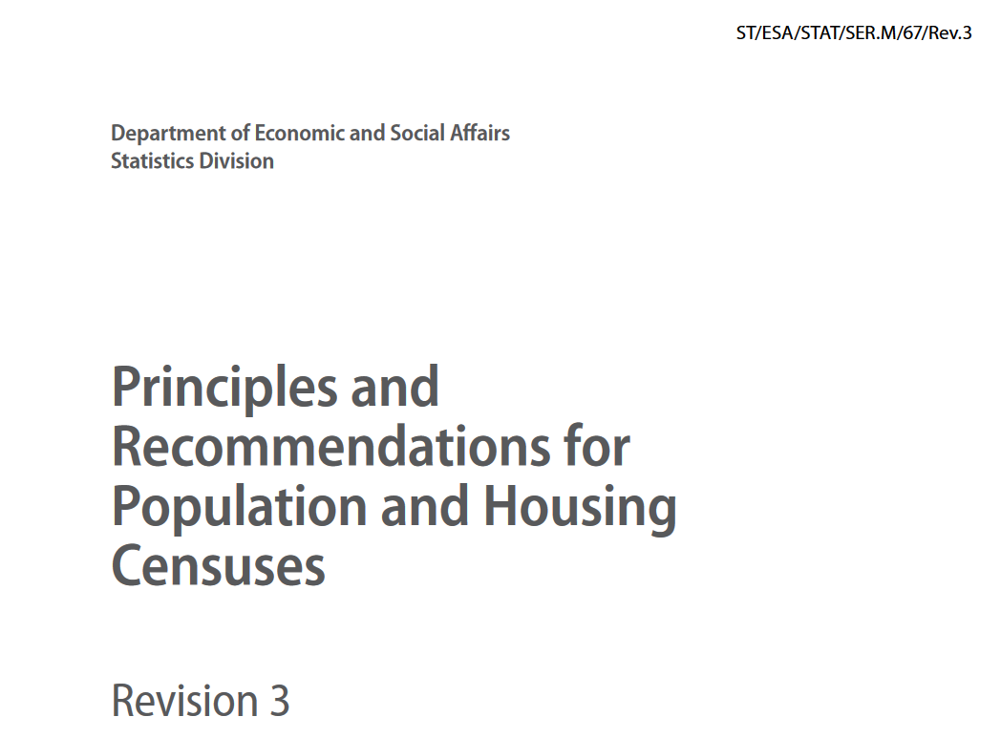
DATA PROTECTION APPROACHES
3.335. As presented in this subsection, there are methods (such as sampling, introduction of random disturbances, recoding and aggregation) that can be used to make such microdata available while still protecting individuals’ rights to privacy. All have in common the fact that they sacrifice some information in order to eliminate or greatly reduce the risk of disclosure. However, it is important that census organizations interested in disseminating microdata to outside users should take the appropriate precautions to protect privacy and confidentiality.
Notes:
SK is permissible.

Slide 13
DATA PROTECTION TREATEMENTS
Purpose: To modulate risk and utility; to add uncertainty to data
In general datasets with:
Many records and few variables = inherently low risk
Many variables and few records = potential risk
In general data treatments:
Remove information: limit risk but also limit utility
Add information: add noise/confusion at a low level, lowering risk while maintaining utility
Notes:
Purpose: To modulate risk and utility; to add uncertainty to data
In general datasets with:
Many records and few variables = inherently low risk due to the small chance of individuation of records.
Conversely, many variables and few records will result in a high number of unique cases - a potential risk.
In general data treatments:
Remove information: to limit risk but often also limit utility
Add information: Some treatments add noise/confusion, lowering risk while maintaining utility.
First, we will describe some key metrics for assessing utility and disclosure risk.
Next, we will give an overview of data treatments to reduce disclosure risk.
Third, we will describe the data treatments that we at IPUMS typically use when preparing census microdata files.
Finally, we will walk through a brief demonstration of this process with code samples.

Slide 14
DATA PROTECTION:
DE-IDENTIFY
name | address | age | sex | marst | relate
John Doe | 123 Main St. | 30 | male | married | head
Jane Doe | 123 Main St. | 30 | female | married | spouse
Jack Doe | 123 Main St. | 4 | male | NA | child
Jill Doe | 123 Main St. | 2 | female | NA | child
Notes:
A simple example illustrating the importance of the question “Useful for what purpose?” is de-identification. Here we see some microdata describing an imaginary household, which includes information on the name and address of each household member.

Slide 15
DATA PROTECTION:
DE-IDENTIFY
id
531
532
533
534
name | address | age | sex | marst | relate
John Doe | 123 Main St. | 30 | male | married | head
Jane Doe | 123 Main St. | 30 | female | married | spouse
Jack Doe | 123 Main St. | 4 | male | NA | child
Jill Doe | 123 Main St. | 2 | female | NA | child
Notes:
In reality, in the statistics office, we don’t necessarily want to throw away the identifying information for ever, but we want to get it out of a file that might be disclosed to a broad audience. Even internally, for most purposes, you want the names removed. You might want to set a permanent ID to each household and person which you can keep linked to the names

Slide 16
DATA PROTECTION:
DE-IDENTIFY
id
531
532
533
534
name | address | age | sex | marst | relate
 |  | 30 | male | married | head
 |  | 30 | female | married | spouse
 |  | 4 | male | NA | child
 |  | 2 | female | NA | child
Notes:
Now we see the same microdata records with the name and address fields removed. Are these microdata less useful than those on the previous slide?
They are certainly less useful for intruders seeking to identify respondents and harvest personal information.
They may also be less useful for certain purposes, such as research on naming conventions or research requiring very detailed information on residential location.
However, for many purposes, such as measuring population or analyzing family formation and living arrangements, these data are just as useful as the data that included name and address.
This is perhaps not a representative example of the trade-offs between utility and privacy, but the principles highlighted here can be applied generally: choose disclosure control techniques that protect privacy by reducing the usefulness of the data for nefarious purposes, while minimally affecting the usefulness of the data for purposes the data producer wants to support.
TOUCH ON BROAD UTILITY - stats offices want to maintain the UTILITY of their data to facilitate demographic / population / policy research, etc

Slide 17
STANDARD IPUMS DATA TREATMENTS
Sampling
Introduction of random disturbances (adding noise)
Swapping, shuffling, perturbing
Suppression
Recoding and aggregation
Notes:
SK is permissible.

Slide 18
STANDARD IPUMS DATA TREATMENTS: SAMPLING
All modern IPUMS International datasets are samples
Samples drawn by NSO or IPUMS
IPUMS provides systematic 1-in-10 sample when possible
Notes:
The first disclosure control treatment I want to discuss is sampling.
Even though IPUMS International disseminates data from censuses, all of our modern datasets, meaning data from 1960 onwards, are samples, not full-count data.
In some cases, our NSO partners share a microdata sample that they constructed, and in other cases, an NSO shares full-count data with us and we construct a sample ourselves.
I should note here that all data shared by our NSO partners is initially stored on restricted-access file-system that is only accessible to a few IPUMS staff members. The data are not moved from this restricted-access area until they have been treated for disclosure control.
When IPUMS draws the sample, we try to provide a systematic 1-in-10 sample whenever possible, and this is what most of our datasets consist of.

Slide 19
SAMPLING AS DISCLOSURE CONTROL
Sampling creates uncertainty:
Is a sample unique a population unique?
?
Notes:
So, how does sampling reduce disclosure risk? Remember that a disclosure occurs when an intruder can confidently identify a respondent based on a unique set of quasi-identifying variables, sometimes called a “key”.
If an intruder received access to full-count census data, and found a respondent with a unique key in those data, they would know with certainty that that key was unique in the population. Then, if they found a match for that key, either based on personal information or in an external database, they could identify that respondent with perfect certainty.
By only providing access to a sample of microdata records, we create uncertainty about whether a respondent that is unique in the sample is actually unique in the population. Thus, even if an intruder makes a unique match between a respondent in the sample and an external information source, they cannot know whether that match would be unique in the population.
The same logic applies for keys shared by only a small number respondents in a dataset: If only ten respondents in a full-count dataset share a key, and an intruder matches that key to an identifiable individual in an external database, they could know with certainty the set of possible values for that individual on sensitive variables in the census microdata. If the microdata are a sample, the intruder cannot know whether the individual in the external database are actually in the microdata, and thus they cannot use the microdata to infer anything about those sensitive variables.
I’d also like to note that sampling reduces disclosure risk without greatly reducing the utility of the microdata for many research purposes. Probability theory ensures that random sampling preserves the relationships between variables in the data within the bounds of sampling error.
Parenthetical (don’t need to highlight in the presentation): There are few if any publicly or commercially available databases that include every individual in a large population. In the context of trying to link an external database to a census sample, this means that even if an intruder can make a link between the external database and a census microdata sample record, they cannot know with certainty that the linked records are from the same individual, because there are likely to be other individuals with the same key values who are not in either database.

Slide 20
RANDOM DISTURBANCE (NOISE): SWAPPING
geog
geog
1
a
1
a
1
b
1
f
2
c
2
c
2
d
2
d
3
e
3
e
3
f
3
b
Notes:
In addition to sampling, we also use record-swapping to reduce disclosure risk by injecting uncertainty into any attempts to re-identify respondents.
I’ll refer to the simplified diagrams on this slide to explain our swapping procedure. Imagine that each row in this table represents a household record and all of the person records in that household. The first column represents all the geography variables associated with each household, and the rest of the columns represent all the non-geographic variables for that household and its members. The color of each household and the labels “a” through “f” are only included to make it easier to distinguish and refer to these imaginary households for the purposes of this description.
In short, our swapping procedure randomly swaps households across geographic units, leaving all non-geographic information about the household intact.
This is illustrated as we move from left to right in this diagram, with household b in geographic unit “1” swapping places with household f in geographic unit “3”, such that household f now appears in geographic unit “1” and household b appears in geographic unit “3”.

Slide 21
SWAPPING AS DISCLOSURE CONTROL
Swapping creates uncertainty:
Is geography accurate for this particular record?
?
Notes:
So, how does swapping reduce disclosure risk? As with sampling, swapping injects uncertainty into any attempts to identify a particular person or household record. Knowing the geographical location of a microdata record is particularly important for an intruder seeking to identify respondents, but with swapping, the intruder can never know with certainty that the geographical location of a particular record is accurate.
Moreover, although we swap a relatively small number of household records to avoid distorting geographic patterns, the proportion of records swapped is not made public, so that potential intruders do not know the level of uncertainty associated with the geographic information in the data.

Slide 22
SUPPRESSION: AGGREGATION
occupation | count
… | …
Statisticians | 51
Mathematicians | 18
Chemists | 33
… | …
occupation | count
… | …
Statisticians and mathematicians | 69
Chemists | 33
… | …
Notes:
The third primary disclosure control treatment that we apply to our data prior to release is small-cell suppression.
For any cells with an observed count of fewer than 25 observations, we combine that value with a related value or move those observations into an “unknown” category.
For example, here we see part of the frequency distribution for a variable on occupation. In the original, sampled data, there are only 18 Mathematicians, which falls below our small-cell threshold. Observations with rare values like these are much more likely to be uniquely identifiable based on a set of quasi-identifiers. Moreover, these small cells are unlikely to add much utility to the data, since there are two few observations to draw inferences about differences between this value and closely-related ones.
Our goal is to, wherever possible, combine related categories so that we lose a minimal amount of detail. Thus, in this example we combine Statisticians and Mathematicians into one category to create a category that is still meaningful but has a lower risk of disclosure. In cases where there is no clearly related category to combine with, we can recode the value with a small cell to an “Unknown” category. Values with a label of “Unknown” can have frequencies below the 25-observation threshold, since they do not reveal any information about a respondent.
SUPPRESSION SHOULD GENERALIZE IN A WAY THAT IS USEABLE
Regionalize by combining geographic units with a neighboring unit whenever one or more of the units has fewer than 20,000 persons in the full count data.

Slide 23
SUPPRESSION: TOP AND BOTTOM-CODING
number_of_rooms | count
… | …
20 | 47
21 | 21
22 | 26
23 | 9
number_of_rooms | count
… | …
20+ | 103
Notes:
For ordered or continuous variables that have a skewed distribution, with relatively few observations with low or high values, we use top or bottom-coding to suppress detail that might be disclosive.
In this example, we combine any households with 20 or more rooms in their dwelling into a single value labeled “20+”.
As mentioned earlier, suppression techniques can actually represent an increase in utility.
EG: re-coding or standardizing of free-response values represents a tremendous value-added for researchers/users of data
IPUMS further enhances utility by harmonizing across time and space within and between samples

Slide 24
SUPPRESSION: GEOGRAPHIC AGGREGATION
Brazil
1980 - 2010
2010
2010
2000
Minas Gerais
over the years
< 20,000 people
2010 | 673 (79%)
2000 | 688 (81%)
1991 | 580 (78%)
1980 | 565 (80%)
1991
1980
1991
Notes:
For variables that identify the geographic unit in which a respondent was enumerated, we use a specialized suppression approach called “regionalization”.
The end result of regionalization is that we never release geographic units that contain low populations, usually less than 20,000 persons in the population.
We accomplish this, first, by only releasing geographic information at a level where enough of the units have sufficient population.
Often, this results in the inclusion of first and second-level administrative geography – for example, regions and provinces or prefectures in the case of Morocco – but depending on the country, we may only be able to include first-level geography, or we may be able to include some very populous third-level units.
Once we have identified the levels that will be released, we perform regionalization by merging any units with too few than 20,000 persons with neighboring units, as shown in the maps above of second-level units within the Brazilian state of Minas Gerais (MEE-nuhz jair-EYES).

Slide 25
SUPPRESSION AS DISCLOSURE CONTROL
Suppression reduces uniqueness:
Sample uniques are rarer
?
?
?
Notes:
Sampling and swapping both increase the uncertainty of any attempts to re-identify respondents, but they do not systematically reduce the number of unique observations in the microdata. Suppression and regionalization directly reduce the number of unique observations in the microdata, making it harder to find unique or nearly-unique cases in the sample that could be linked to direct identifiers in external data.
As with our sampling and swapping procedures, our suppression procedure reduces the risk of re-identification without unduly sacrificing utility. Because values that are suppressed are by definition those with few observations, even the original, unsuppressed data could not support inferences about the difference between those observations and others with closely related values.

Slide 26
CAUTION: CONSIDER RELATED VARIABLES
Age: more than just age
If you top-code age, make sure to bottom-code Birth Year
Other changes in age can have implications noise infusion could affect eduction, working age, etc.
Other commonly related variables:
Country of birth/nationality
Occupation, industry, employment status, etc

Slide 27
TAKING A BALANCED APPROACH
Safe projects
Responsible data stewardship
Ensures data usage
Protects against re-identification
Considers the use case and usage environment
Safe people
Safe data
Safe settings
Safe output
DATA
SAFETY
DATA
UTILITY

Slide 28
References
Dupriez, Olivier and Ernie Boyko. 2010. “Dissemination of Microdata Files. Formulating Policies and Procedures”, International Household Survey Network, IHSN Working Paper No 005. http://ihsn.org/sites/default/files/resources/IHSN-WP005.pdf
Hundepool, Anco, Josep Domingo-Ferrer, Luisa Franconi, Sarah Giessing, Rainer Lenz, Jane Naylor, Eric Schulte Nordholt, Giovanni Seri, and Peter-Paul De Wolf. 2010. Handbook on Statistical Disclosure Control, version 1.2. ESSNet SDC. https://cros-legacy.ec.europa.eu/system/files/SDC_Handbook.pdf

Slide 29
References
risk assessment:
sdcMicro User Guide: https://sdcpractice.readthedocs.io/en/latest/intro.html
sdcMicro is an R package produced by The World Bank, in collaboration with Intl Household Survey Network (IHSN), PARIS21 (OECD), Statistics Austria and the Vienna University of Technology.
k-anonymity:
Samarati, Pierangela; Sweeney, Latanya (1998). "Protecting privacy when disclosing information: k-anonymity and its enforcement through generalization and suppression" (PDF). Harvard Data Privacy Lab. Retrieved April 12, 2017.
critiques of k-anon and expansions (t-closeness):
N. Li, T. Li and S. Venkatasubramanian, "t-Closeness: Privacy Beyond k-Anonymity and l-Diversity," 2007 IEEE 23rd International Conference on Data Engineering, Istanbul, Turkey, 2007, pp. 106-115, doi: 10.1109/ICDE.2007.367856.
Utility Assessment: sdcMicro material and the synthpop team (Based at University of Edinburgh):
"Assessing, visualizing and improving the utility of synthetic data." Raab, G. UNECE CONFERENCE OF EUROPEAN STATISTICIANS:
Expert Meeting on Statistical Data Confidentiality
1-3 December 2021, Poland
https://unece.org/sites/default/files/2021-12/SDC2021_Day2_Raab_AD.pdf

