Slide 1
SDMX Scenarios: Overview
Photo by Markus Spiske, unsplash
7th Regional Workshop on Data and Metadata Exchange for Reporting on SDGs
Egypt, Cairo
3 – 5 June 2024
Abdulla Gozalov
United Nations Statistics Division

Slide 2
Objectives of SDMX
SDMX was originally designed to standardize data and metadata exchange between and among international organizations and member countries.
However, the power and utility of its underlying information model has increasingly broadened the scope of use of SDMX in addition to data/metadata exchange
Processing
Validation
Dissemination
Data and metadata management

Slide 3
Scenarios for SDMX Reporting and Dissemination
Thanks to the availability of a large number of powerful tools that rely on a common Information Model, application of SDMX is fully scalable and can be adapted to many environments.
Some commonly used tools, such as SDMX Converter, can be used with very limited infrastructure in place.
In more sophisticated environments, however, other tools and platforms are even more efficient in the automation of business processes, further reducing the effort required to establish automated data reporting, dissemination, and other processes.
We will now look at some of the common scenarios of the application of SDMX for reporting and dissemination.

Slide 4
Scenario: no database to SDMX
data
DSD
SDMX
data
mappings
Map data files to a DSD
Once mapped, use a tool such as SDMX Converter to transform the files to SDMX datasets
No software development!
Most effort goes to mapping data files to the DSD
Can vary from very simple to very complex
Can be used with Eurostat’s SDMX Converter, ILO SMART, and other tools.
We have extensively covered this scenario at previous training events.

Slide 5
Scenario: relational database to SDMX
DSD
SDMX Web Service/API
SDMX
mappings
data
Use software such as SDMX Reference Infrastructure to map a statistical database to the DSD
Once mapped, the data is available at the SDMX API
No software development!
Most effort goes to mapping the database to the DSD
This is the scenario will be working on at this workshop.

Slide 6
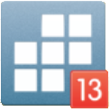
Scenario: micro-data to SDMX
micro-data
DSD
ILO SMART
SDMX
micro-data
aggregation and mappings
The ILO SMART tool enables the user to define aggregation operations on micro-data sets, map the aggregates to codes and concepts of a DSD, and convert the data to SDMX
No software development
Most effort goes to defining aggregation and mapping

Slide 7
Scenario: Native SDMX data warehouse
In this scenario, reporting or dissemination is fully based on SDMX.
SDMX datasets can be automatically loaded into a database created on the basis of SDMX DSDs and other structural metadata.
.Stat Data Lifecycle Manager (part of the .Stat suite), ISTAT Data Manager (part of the ISTAT Toolkit), and Regnology Fusion Statistics (formerly Fusion Registry Enterprise) are some of the tools that implement this paradigm.
Data loaded to the database are automatically available at an SDMX API.

Slide 8
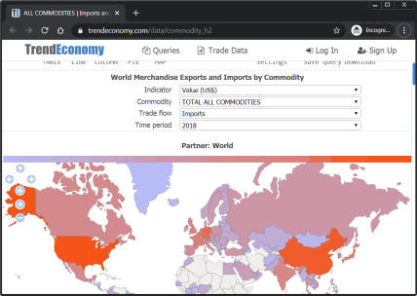
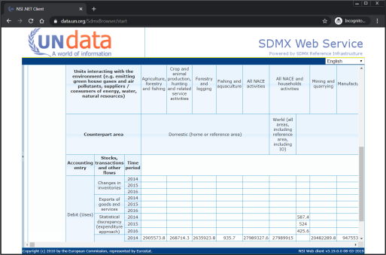
What then?
Once converted to SDMX, a variety of platforms can be used to disseminate and visualize the data
SDMX Web Service/API

Slide 9
Designing data life cycle
These scenarios are not an exhaustive list. Many others are possible, and these scenarios themselves can be combined or modified.
When developing systems architecture, factors such as available infrastructure, skills, and overall development strategy should be considered to design an architecture most appropriate to a statistical office.
To achieve highest business process efficiency while improving data quality, timeliness, availability, and usability.

Slide 10
THANK YOU!

