Slide 1



SDMX Information Model
Photo by Markus Spiske, unsplash
Abdulla Gozalov
UNSD-ESCWA Advanced SDMX Workshop
Beirut, 27 Jun – 1 Jul 2022

Slide 2

Figures vs data
Number
Tourism establishments
Italy
Annual data
Figures by themselves are meaningless.
For data to be usable, it must be properly described. The descriptions let users know what the data actually represents.
2529
Notes:
Any statistical table is a set of observations or measures.
But the observation itself means nothing.
We need metadata to identify the figure such as the Tourism establishments, the unit, the country, the frequency, the time…
This information will be called structural metadata.
We can now introduce our fist SDMX object: the Concept.
The concept is a label describing the data.
It has an ID, a name and description in several languages.

Slide 3
Developing a Data Model for Data Exchange
Data model is developed to provide descriptions for all relevant characteristics of the data to be exchanged
In some aspects similar to developing a relational database
In SDMX, data model is represented by a Data Structure Definition (DSD).
The “shape” of SDMX DSD is roughly similar to star schema.
To design a DSD, we first need to find concepts that identify and describe our data.

Slide 4
Concept
“Unit of thought created by a unique combination of characteristics”*
Each concept describes something about the data.
Concepts should express all relevant data characteristics.
* Source: SDMX Glossary

Slide 5
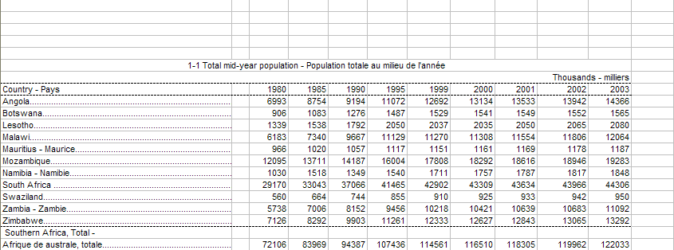
Identifying Concepts
Indicator
Time Period
Ref. Area
Unit Multiplier
Obs. Value

Slide 6
SDMX Concept Scheme
“Set of Concepts that are used in a Data Structure Definition or Metadata Structure Definition.”*
Concept scheme places concepts into a maintainable unit.
Concept name | Concept ID
Indicator | INDICATOR
Reference area | REF_AREA
Time period | TIME_PERIOD
Unit multiplier | UNIT_MULT
Observation value | OBS_VALUE
* Source: SDMX Glossary

Slide 7
Dimension
Which of the concepts are used to identify an observation?
  Indicator
  Reference area
  Time Period
When all 3 are known, we can unambiguously locate an observation in the table.
These are called dimensions.
  A dimension is similar in meaning to a database table’s primary key field.

Slide 8
Attribute
In our example, Unit Multiplier represents additional information about observations.
This concept is not used to identify a series or observation.
Such concepts are called attributes.
  Not to be confused with XML attributes!
  Similar to a database table’s non-primary key fields.

Slide 9
Primary Measure
Observation Value represents a concept that describes the actual values being transmitted.
In SDMX, such a concept is called Primary Measure.
Primary Measure is usually represented by concept with ID OBS_VALUE.

Slide 10
Dimension or Attribute?
Choosing the role of a concept has profound implications on the structure of data.
Concepts that identify data, should be made dimensions. Concepts that provide additional information about data, should be made attributes.
If a concept is a dimension, it is possible to have time series that are different only in the value of this concept.
  E.g. if Unit of Measure is a dimension, it is possible to have separate time series for “T” and “T/HA” or, more controversially, “KG” and “T”

Slide 11
Dimension or Attribute? (2)
Cambodia
Fixed and Mobile telephone subscriptions | 2013 | 20.6 million
Fixed and Mobile telephone subscriptions | 2012 | 19.7 million
Fixed and Mobile telephone subscriptions | 2013 | 140.9 per 100 pop.
Unit of measure as a dimension… (dimensions underlined)
Ref.Area | Indicator | Time Period | Unit | Unit Mult. | Obs. Value
Cambodia | Fixed and Mobile telephone subscriptions | 2013 | Number | Millions | 20.6
Cambodia | Fixed and Mobile telephone subscriptions | 2012 | Number | Millions | 19.7
Cambodia | Fixed and Mobile telephone subscriptions | 2013 | Per 100 pop. | Units | 140.9

Slide 12
Dimension or Attribute? (3)
Unit of measure as an attribute…
Violation!
Ref.Area | Indicator | Time Period | Unit | Unit Mult. | Obs. Value
Cambodia | Fixed and Mobile telephone subscriptions | 2013 | Number | Millions | 20.6
Cambodia | Fixed and Mobile telephone subscriptions | 2012 | Number | Millions | 19.7
Cambodia | Fixed and Mobile telephone subscriptions | 2013 | Per 100 pop. | Units | 140.9
The dataset above is invalid: duplicate observation
The two values above are only different in their attributes

Slide 13
Dimension or Attribute? (4)

Unit of measure as an attribute…
Ref.Area | Indicator | Time Period | Unit | Unit Mult. | Obs. Value
Cambodia | Fixed and Mobile telephone subscriptions | 2013 | Number | Millions | 20.6
Cambodia | Fixed and Mobile telephone subscriptions | 2012 | Number | Millions | 19.7
Cambodia | Fixed and Mobile telephone subscriptions per 100 population | 2013 | Per 100 pop. | Units | 140.9
Now there is no violation because every row has a unique key
The Unit concept is still useful

Slide 14
Attribute attachment
In SDMX 2.0, attributes can be attached at observation, time series, group, or dataset level.
In SDMX 2.1, attributes can be attached at observation, dimension(s), group, or dataset.
  When an attribute is attached to all dimensions except time, it is effectively attached to time series
For practical purposes attributes are often attached at observation or time series.
In addition, attributes can be designated as mandatory or conditional (optional). Mandatory attributes must be present at their attachment level for the dataset to be valid, while conditional attributes may be skipped.
  Dimensions, by contrast, must always be provided.

Slide 15
Cross-domain Concepts
SDMX Statistical Working Group (SWG) develops and publishes Cross-Domain Concepts
These are recommended concept IDs that are shared among statistical subject-matter domains and can be reused in many DSDs. The full list of cross-domain concepts is available at the SDMX web site under Guidelines: https://sdmx.org/?page_id=3215
The cross-domain concept scheme is also published at the SDMX Global Registry: https://registry.sdmx.org

Slide 16
Cross-domain Concepts: examples
Some of the widely used cross-domain concepts include:
  Statistical indicator: INDICATOR
  Reference area: REF_AREA
  Sex: SEX
  Age: AGE
  Unit of measure: UNIT_MEASURE
  Unit multiplier: UNIT_MULT
  Time period: TIME_PERIOD
  Observation value: OBS_VALUE

Slide 17
Data model so far...
Concept | ID | Role | Attachment
Indicator | INDICATOR | Dimension
Reference area | REF_AREA | Dimension
Time period | TIME_PERIOD | Dimension
Unit multiplier | UNIT_MULT | Attribute | Time series
Observation value | OBS_VALUE | P.Measure

Slide 18
Representation
DSD defines a range of valid values for each concept.
When data are transferred, each of its descriptor concepts must have valid values.
A concept can be
  Coded
  Un-coded with format
  Un-coded free text

Slide 19
Code
“A language-independent set of letters, numbers or symbols that represent a concept whose meaning is described in a natural language.”
A sequence of characters that can be associated with descriptions in any number of languages.
  Descriptions can be updated without disrupting mappings or other components of data exchange.

Slide 20
Code List
“A predefined list from which some statistical coded concepts take their values.”
A code list is a collection of codes maintained as a unit.
A code list enumerates all possible values for a concept or set of concepts
  Sex code list
  Country code list
  Indicator code list, etc

Slide 21
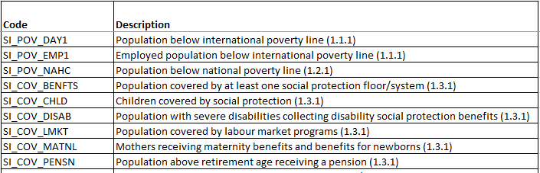
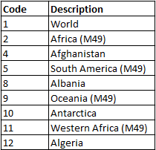
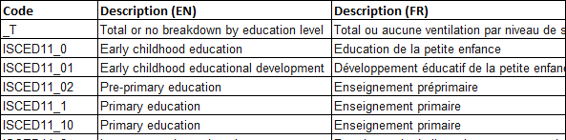
Code List: Some Examples
CL_SERIES
CL_AREA
CL_EDUCATION_LEV

Slide 22
SDMX Concepts and Code lists
Code lists provide a representation for concepts, in terms of Codes.
Codes are language-independent and may include descriptions in multiple languages.
Code lists must be harmonized among all data providers that will be involved in exchange.

Slide 23
Un-coded Concepts
Can be free-text: Any valid text can be used as a value for the concept.
  Footnote
Can have their format specified
  Postal code: 5 digits
  Last update: date/time

Slide 24
Representation of concepts in SDMX
Dimensions must be either coded or have their format specified.
  Free text is not allowed.
Attributes can be coded or un-coded; format may optionally be specified.

Slide 25
Data model so far…
Concept | ID | Role | Attachment | Representation
Indicator | INDICATOR | Dimension |  | CL_INDICATOR
Reference area | REF_AREA | Dimension |  | CL_AREA
Time period | TIME_PERIOD | Dimension |  | Date/time (YYYY)
Unit multiplier | UNIT_MULT | Attribute | Time series | CL_UNIT_MULT
Observation value | OBS_VALUE | Pr. Measure |  | Floating point number

Slide 26
Cross-domain Code Lists
Similar to cross-domain concepts, SDMX Statistical Working Group (SWG) develops and publishes Cross-Domain Code Lists.
When available, these are based on existing statistical classifications and contain codes from those classifications. Otherwise, codes are developed by the SWG.
These codes should be used whenever possible in SDMX exchange or dissemination. The code lists are often extended with country or organization-specific codes. For example, the global Reference Area code list is often extended with subnational reference area codes for national data dissemination.

Slide 27
Cross-domain Concepts and Code Lists: examples
Reference area: REF_AREA → CL_AREA
Sex: SEX → CL_SEX
Unit multiplier: UNIT_MULT → CL_UNIT_MULT

Slide 28
Generic cross-domain codes
Recommended Code Value | Recommended Code Description
_L | Local extension (can be used as a prefix)
_N | Non response
_O | Other
_S | Subtotal
_T | Total
_U | No data/unknown
_X | Not allocated/unspecified
_Z | Not applicable
These codes are recommended to be used in all code lists as appropriate.
* Source: Guidelines for the creation and Management of SDMX Code Lists

Slide 29
Data model so far: Code Lists
CL_INDICATOR
Code | Name
POP | Total Mid-Year Population
CL_AREA (partial)
Code | Name
AF | Afghanistan
AL | Albania
AQ | Antarctica
DZ | Algeria
AS | American Samoa
AD | Andorra
CL_UNIT_MULT
Code | Name
0 | Units
1 | Tens
2 | Hundreds
3 | Thousands
6 | Millions
9 | Billions

Slide 30
Data Structure Definition: summary
Concept Scheme
Reference
DSD
Reference
Code lists
Concept | Concept ID | Role | Attachment | Representation | Code list ID
Indicator | INDICATOR | Dimension |  | Code List | CL_INDICATOR
Reference area | REF_AREA | Dimension |  | Code List | CL_AREA
Time period | TIME_PERIOD | Dimension |  | YYYY
Unit multiplier | UNIT_MULT | Attribute | Time series | Code List | CL_UNIT_MULT
Obs. value | OBS_VALUE | Pr. Measure |  | Floating point number

Slide 31
Importance of Data Model
Data model, represented by DSD, defines what data can be encoded and transmitted.
Flaws in a DSD may have significant adverse impact on data exchange
  Missing concepts
  Incorrect role of concepts
  Un-optimized model

Slide 32
Dataset
Organised collection of data defined by a Data Structure Definition (DSD)*
A dataset is structured in accordance with one DSD
Serves as a container for time-series or cross-sectional series in SDMX data messages.
*Source: SDMX Glossary

Slide 33
Time Series
A set of observations of a particular variable, taken at different points in time.
Observations that belong to the same time series, differ in their time dimension.
  All other dimension values are identical.
  Observation-level attributes may differ across observations of the same time series.

Slide 34
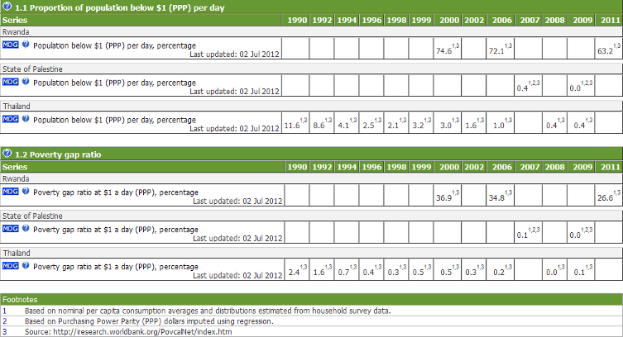
Time Series: Demonstration

Slide 35
Non-Time Series Data
(a.k.a. Cross-Sectional Data¹)
A non-time dimension(s) is chosen along which a set of observations is constructed.
  E.g. for a survey or census the time is usually fixed and another dimension may be chosen to be reported at the observation level
Used less frequently than time series representation

Slide 36
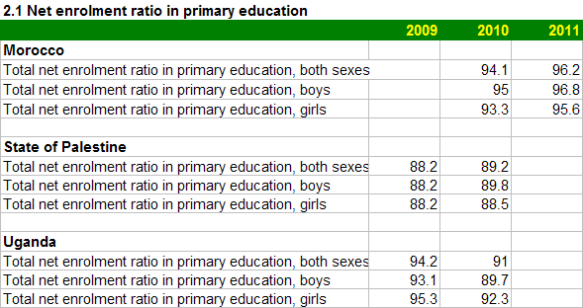
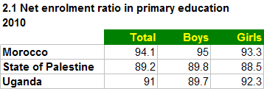
Time Series View vs Cross-Sectional View
The Sex dimension was chosen as the cross-sectional measure.
Note that Time is still applicable.

Slide 37
Keys in SDMX
Series key uniquely identifies a series
  In the case of time series, consists of all dimensions except time
Group key uniquely identifies a group of time series
  Consists of a subset of the series key

Slide 38

Structural and Reference Metadata
Structural Metadata: Identifiers and Descriptors, e.g.
  Data Structure Definition
  Concept Scheme
  Code
Reference Metadata: Describes contents and quality of data, e.g.
  Indicator definition
  Comments and limitations
What we have covered
so far

Slide 39
Reference Metadata in SDMX
Can be stored or exchanged separately from the object it describes, but be linked to it
Can be indexed and searched
Reported according to a defined structure

Slide 40
Metadata Structure Definition (MSD)
MSD Defines:
  The object type to which reference metadata can be associated
    E.g. DSD, Dataflow.
  The components comprising the object identifier of the target object
    E.g. the draft SDG MSD allows metadata to be attached a partial key.
  Concepts used to express metadata (“metadata attributes”).
    E.g. Indicator Definition, Quality Management

Slide 41
Reference metadata in SDMX 3.0
Reference metadata support will be redesigned in SDMX 3.0.
  To simplify implementation, discovery, and use
It will be possible to declare reference metadata concepts directly in the DSD, and transmit reference metadata as part of a dataset or in a separate message.
Metadata Structure Definitions, metadata sets, and metadata flows will still be supported for higher-level metadata that is not attached to specific datasets.
It is expected that simplification of reference metadata will lead to its implementation in common tools as well as much broader usage.

Slide 42
Dataflow and Metadataflow
Dataflow defines a “view” on a Data Structure Definition
  Can be constrained to a subset of codes in any dimension
  Can be categorized, i.e. can have categories attached
  In its simplest form defines any data valid according to a DSD
Similarly, Metadataflow defines a view on a Metadata Structure Definition.

Slide 43
Content Constraints
Constraints can be used to define which codes or combinations of codes are allowed (or disallowed)
Constraints can define more granular validation rules than a simple validation of codes
Are often attached to the Dataflow but can also be attached to DSD, Provision Agreement, etc

Slide 44
Content Constraint Types
Cube Region Constraints define valid (or invalid) codes as a subset of those defined in a DSD’s code lists.
  E.g. for the Country Global SDG Dataflow, the only valid value for dimension REPORTING_TYPE is N (“National”).
Series Constraints define valid (or invalid) combinations of codes defined in a DSD’s code lists.
  SERIES=SH_STA_STNT (Proportion of children moderately or severely stunted)
  AGE=Y0T4 (Under five years old)
  COMPOSITE_BREAKDOWN=_T,MS_MIGRANT,MS_NOMIGRANT,MS_EUMIGRANT, or MS_NONEUMIGRANT
  PRODUCT=_T
  ACTIVITY=_T

Slide 45
Category, Category Scheme, and Categorisation
Category is a way of classifying data for reporting or dissemination
  Subject matter-domains are commonly implemented as Categories, such as “Demographic Statistics”, “Economic Statistics”
Category Scheme groups Categories into a maintainable unit.
Categorisation links a Category to the object to which it applies.

Slide 46
SDMX Messages
Any SDMX-related information is exchanged in the form of documents called messages. An SDMX message can be sent in a number of standard formats including XML, JSON, CSV.
There are several types of SDMX messages, each serving a particular purpose, e.g.
  Structure message is used to transmit structural information such as DSD, MSD, Concept Scheme, etc.
  GenericData, StructureSpecificData, and other messages are used to send data.
SDMX messages in the XML format are referred to as SDMX-ML messages.

Slide 47
SDMX Artefacts
While there are many types of artefacts, in almost all situations “SDMX Artefact” refers to a maintainable and versionable component of structural metadata.
  Concept Scheme
  DSD
  Code List
Note that e.g. an individual Code is not an artefact, since it can only exist and be transmitted as part of a Code List.

Slide 48
SDMX Artefact Identification and Versioning
Identification of SDMX Artefact consists of 3 fields: ID; Maintenance Agency; Version
Type | Name | ID | Maintenance Agency | Version
DSD | NA Main Aggregates | NA_MAIN | ESTAT | 1.11
DSD | NA Main Aggregates | NA_MAIN | ESTAT | 1.10
Concept Scheme | SDG Concept Scheme | SDG_CONCEPTS | IAEG-SDGs | 1.0
Code List | Reference area code list | CL_AREA | SDMX | 2.0

Slide 49
THANK YOU

