Slide 1
SDMX: News and Developments
UNSD-ESCWA 6th Regional Workshop on Data and Metadata Exchange for SDG Monitoring
Amman, 5-8 June 2023
Abdulla Gozalov
United Nations Statistics Division

Slide 2
11th SDMX Experts Meeting
Took place on 28 Nov – 1 Dec 2022 in Aguascalientes, Mexico
Topics included the implementation of SDMX 3.0; data modeling and governance; capacity building; linkage of SDMX with other standards.
Automated translation of SDMX structural and reference metadata a major focus of interest
Fusion Metadata Registry has already implemented most of support for SDMX 3.0 structural and reference metadata
Support for SDMX 3.0 data and metadata exchange forthcoming in tools
Materials available at the meeting web site.

Slide 3
SDMX User Forum
Launched in December 2022 at the SDMX Experts Meeting
Based on Yammer, part of the Global Network of Data Officers and Statisticians, run by UNSD
Open to any user, regardless of their level of knowledge
Platform for knowledge sharing, problem solving and collaboration
  Ask or answer questions
  Find solutions
  Connect with experts and peers
Actively used, 300+ users
See instructions for joining

Slide 4

sdmx.io
https://sdmx.io
Ecosystem of open source tools, patterns, guidance, learning materials and other resources
Software tools and other materials for
  Data modellers and metadata managers
  Statisticians, data collectors, data reporters and data publishers
  IT experts
Learning resources

Slide 5
SDMX Capacity Building
Provided as part of regular training programmes or specific projects
Provided at global events, in particular the SDMX Global Conference
Since the pandemic, e-learning courses increasingly a focus

Slide 6
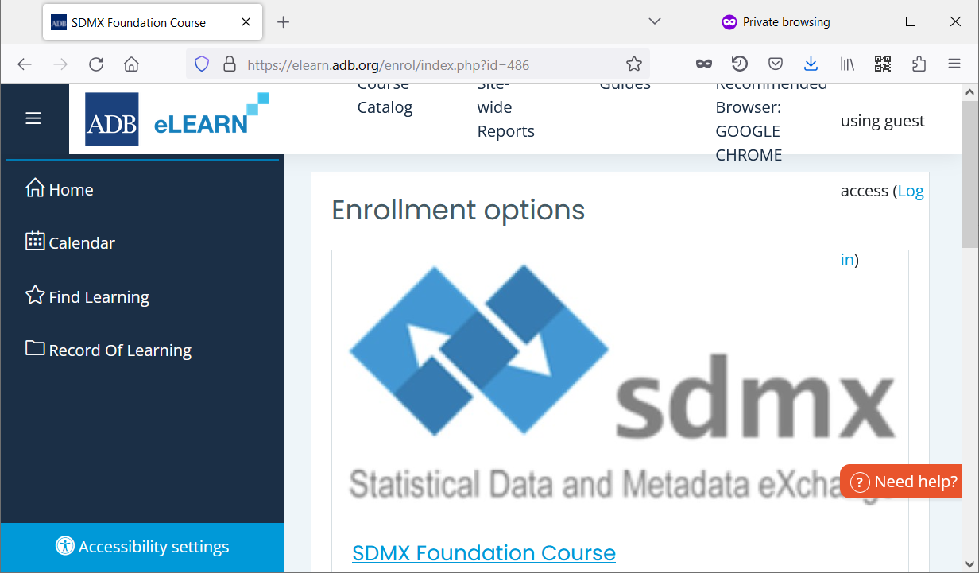
SDMX Foundation e-learning course
Introductory course developed by the Asian Development Bank in cooperation with UNSD, UNESCAP, and SIAP
Module 1: Overview and Business Case
  Management and technical expert oriented
Module 2: SDMX Information Model, Content-Oriented Guidelines, IT Architecture and Tools, implementation steps
  Technical expert oriented
Register at https://elearn.adb.org/course/view.php?id=486

Slide 7
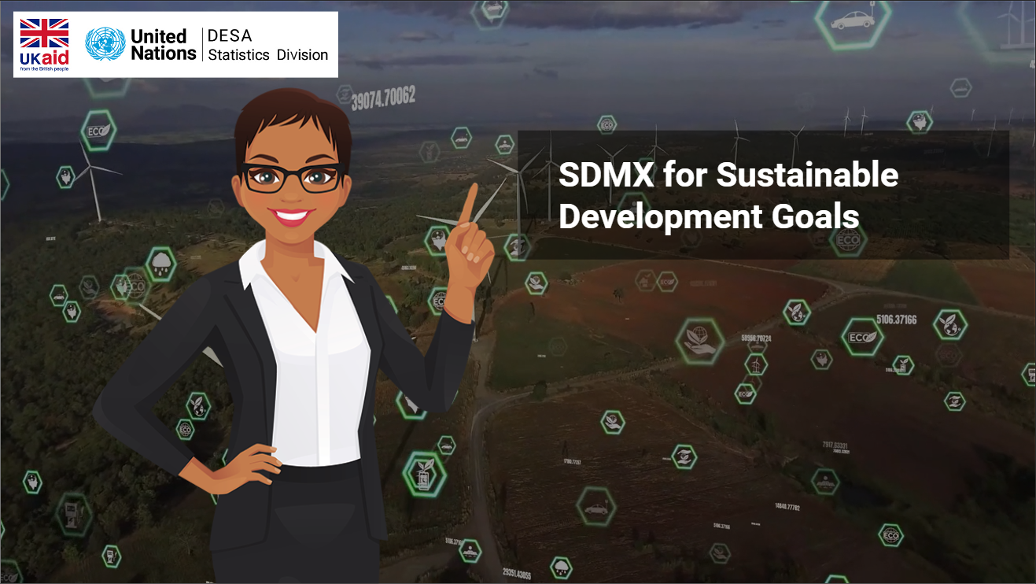
SDMX-SDGs e-learning course
Developed by UNSD and the SDMX-SDG Working Group in support of data exchange and dissemination of the Sustainable Development Goals indicators
Intended for participants who have a basic knowledge of SDMX and wish to learn the SDGs data exchange and dissemination
The SDMX Foundation course can be taken prior to the SDMX-SDGs course to satisfy the prerequisites
Explores the SDG DSD, dataflows, content constraints, customization, and other aspects of SDG data exchange
Register at https://learning.officialstatistics.org/course/view.php?id=96

Slide 8
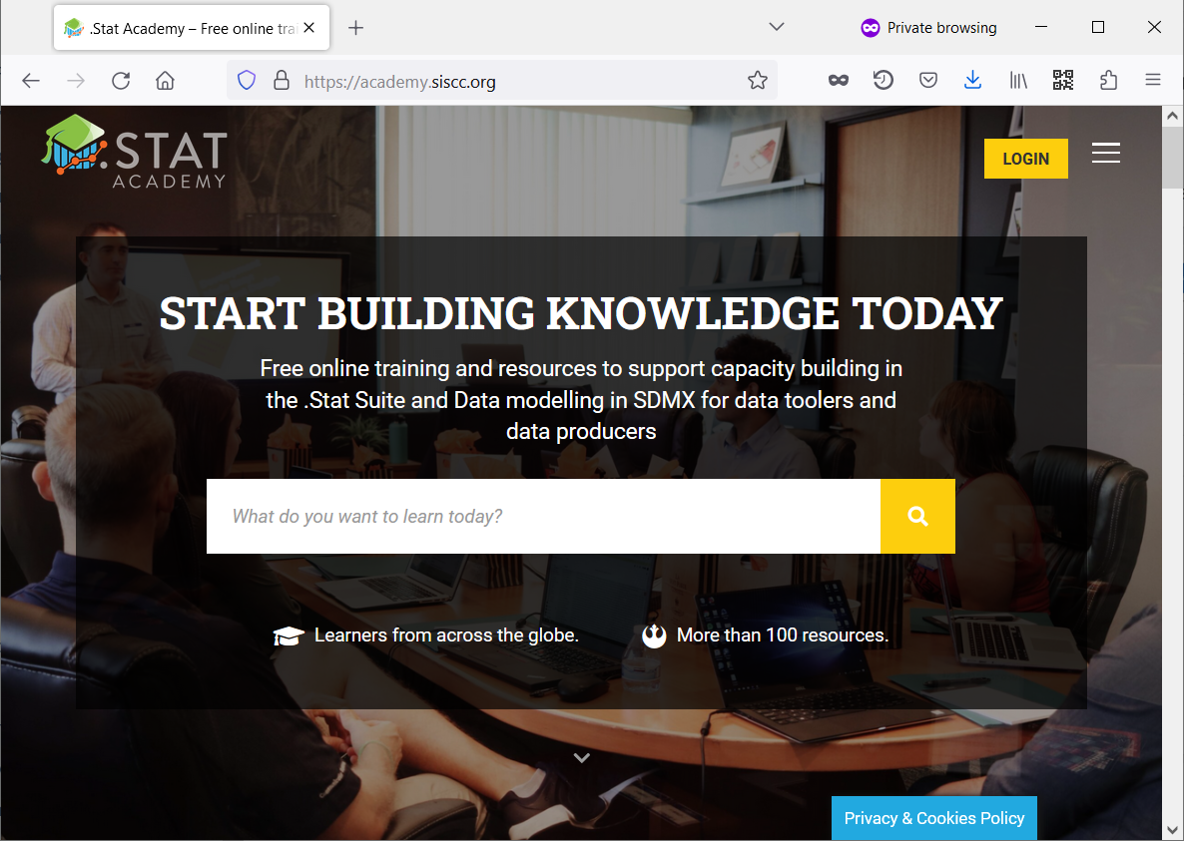
.Stat Academy
Virtual online environment where experts share knowledge and expertise through training courses, webinars, and other resources
Maintained by the Statistical Information System Collaboration Community (SIS-CC)
Built around the .Stat Suite, an SDMX native data warehouse
  Consequently, covers many SDMX topics
Many e-learning courses available, more on the way
https://academy.siscc.org/

Slide 9
9th SDMX Global Conference
Will be held on 29 Oct – 2 Nov 2023 in Bahrain
  In-person for the first time since 2019
2023 Conference theme: Empowering Data Communities
Brings together National Statistical Offices, Central Banks, international agencies, academia, private sector
Focus on
  Implementation of SDMX 3.0
  Open-source software tools
  Validation and Transformation Language (VTL)
  SDMX and other standards

Slide 10
THANK YOU!
Questions?

