Slide 1

SDMX Conversion & Transfer
ICTS

Slide 2
High-level Overview
Login & Access the SDMX converter
File Upload and Successful Conversion
File Upload and Failed Conversion

Slide 3
High-level Overview
Login & Access the SDMX converter
File Upload and Successful Conversion
File Upload and Failed Conversion

Slide 4
Access to the SDMX conversion
Use the following Link to access the tool: http://10.30.31.58:5000/sdmx/converter
Username(lowercase): sdmx-{first name}
Password: Convert@SDMX

Slide 5
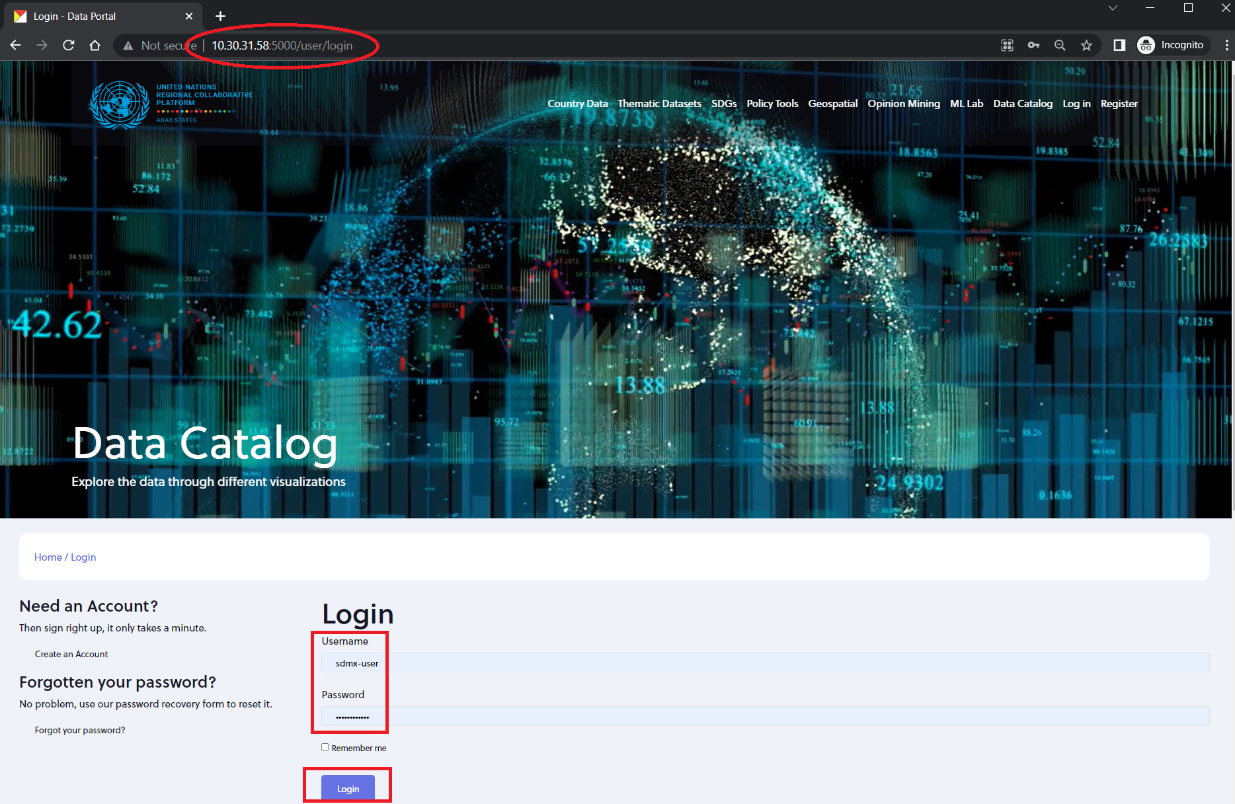
Login & Access the SDMX converter
Go to http://10.30.31.58:5000/user/login
Use these credentials
  Username(lowercase): sdmx-{first name}
  Password: Convert@SDMX
Click Login

Slide 6
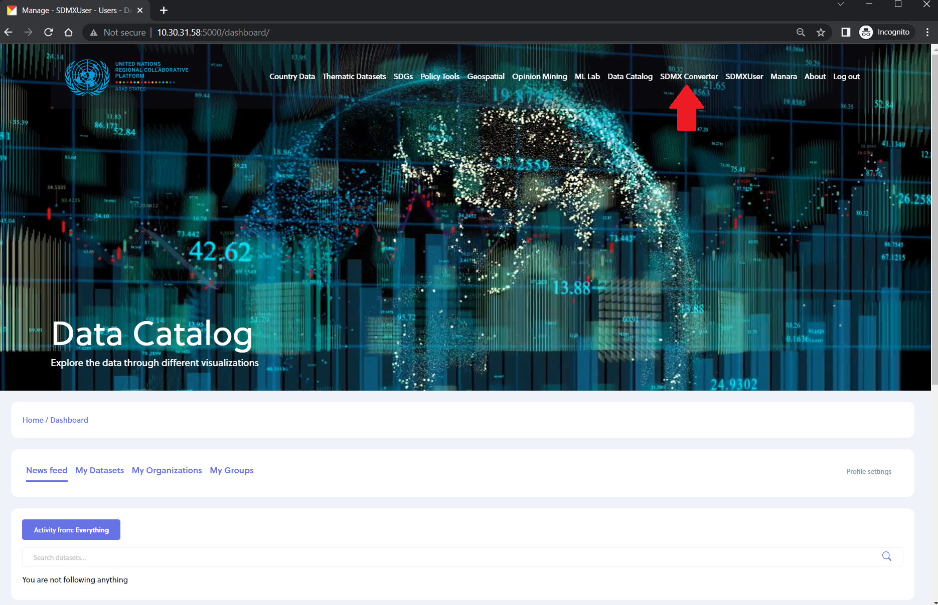
Login & Access the SDMX converter
Once logged in, click on SDMX Converter from the top menu or go to http://10.30.31.58:5000/sdmx/converter

Slide 7
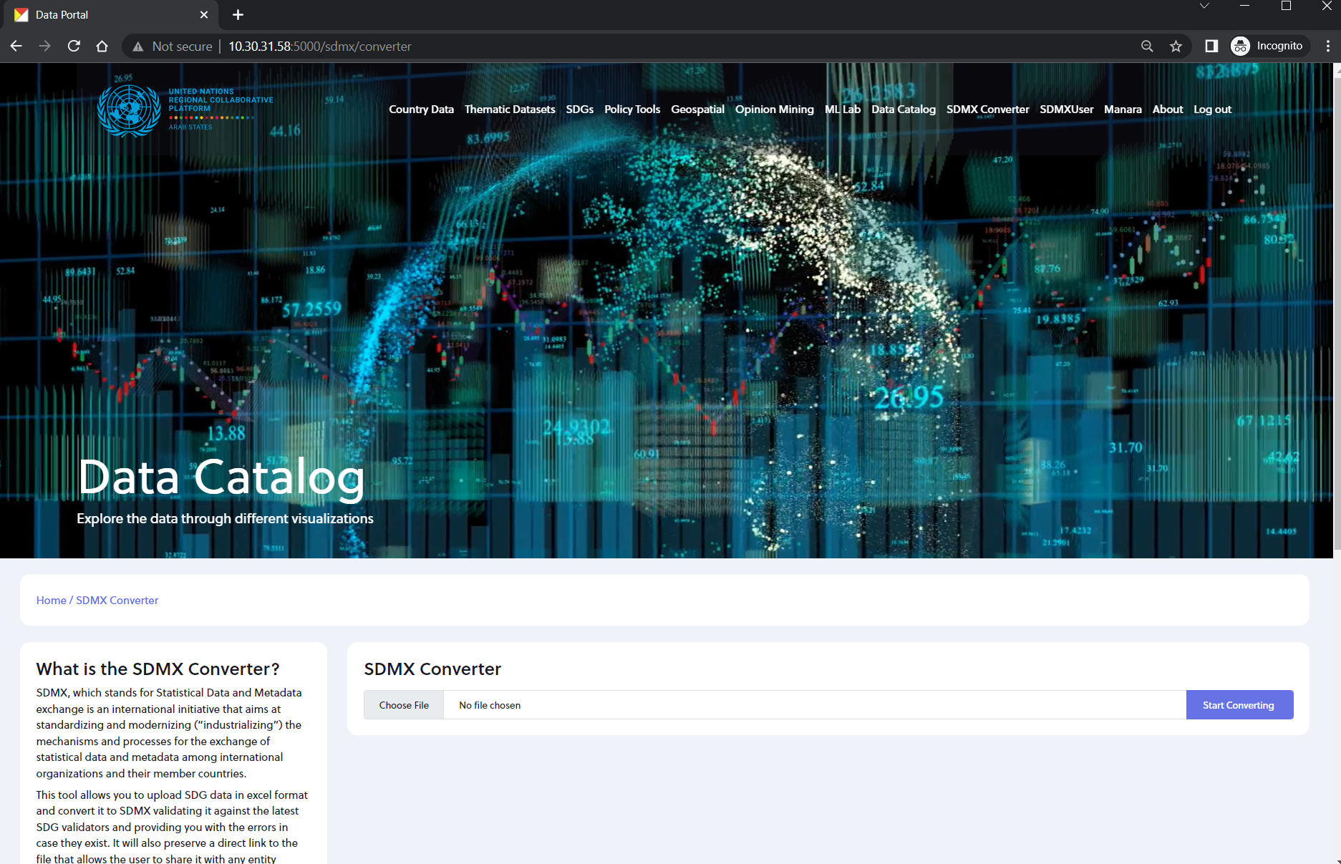
Login & Access the SDMX converter
We should get this display

Slide 8
High-level Overview
Login & Access the SDMX conversion
File Upload and Successful Conversion
File Upload and Failed Conversion

Slide 9
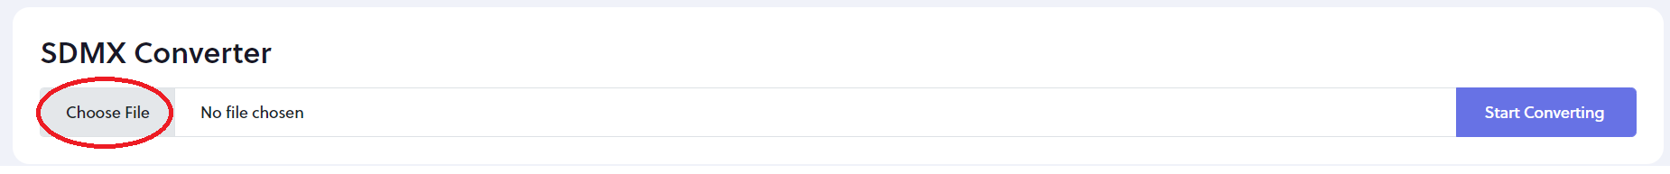
File Upload and Successful Conversion
Click on Choose File

Slide 10
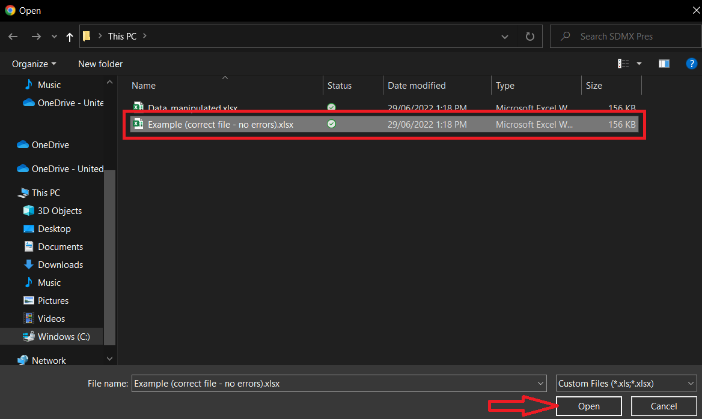
File Upload and Successful Conversion
Browse to your excel file to select it
Click Open

Slide 11
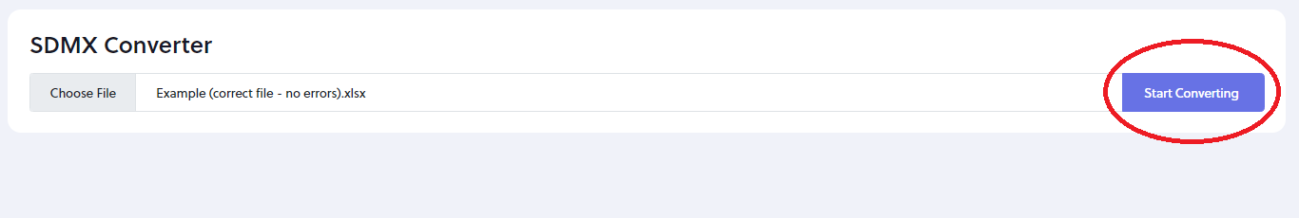
File Upload and Successful Conversion
Click Start Converting

Slide 12
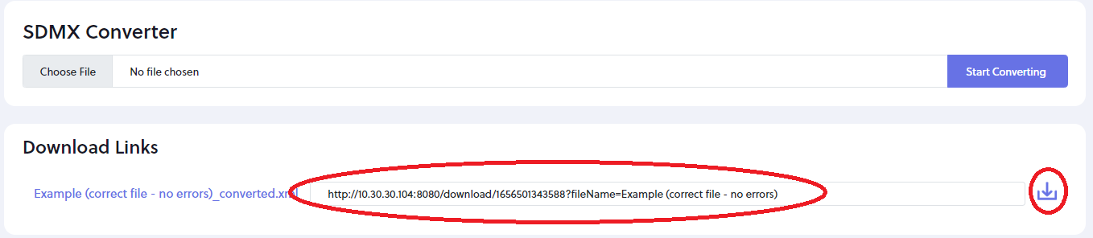
File Upload and Successful Conversion
If there are no errors, we will get the download links.
We can also share the displayed link with colleagues if needed.
Data is transferred to our database and sent to relevant entities for validation

Slide 13
High-level Overview
Login & Access the SDMX conversion
File Upload and Successful Conversion
File Upload and Failed Conversion

Slide 14
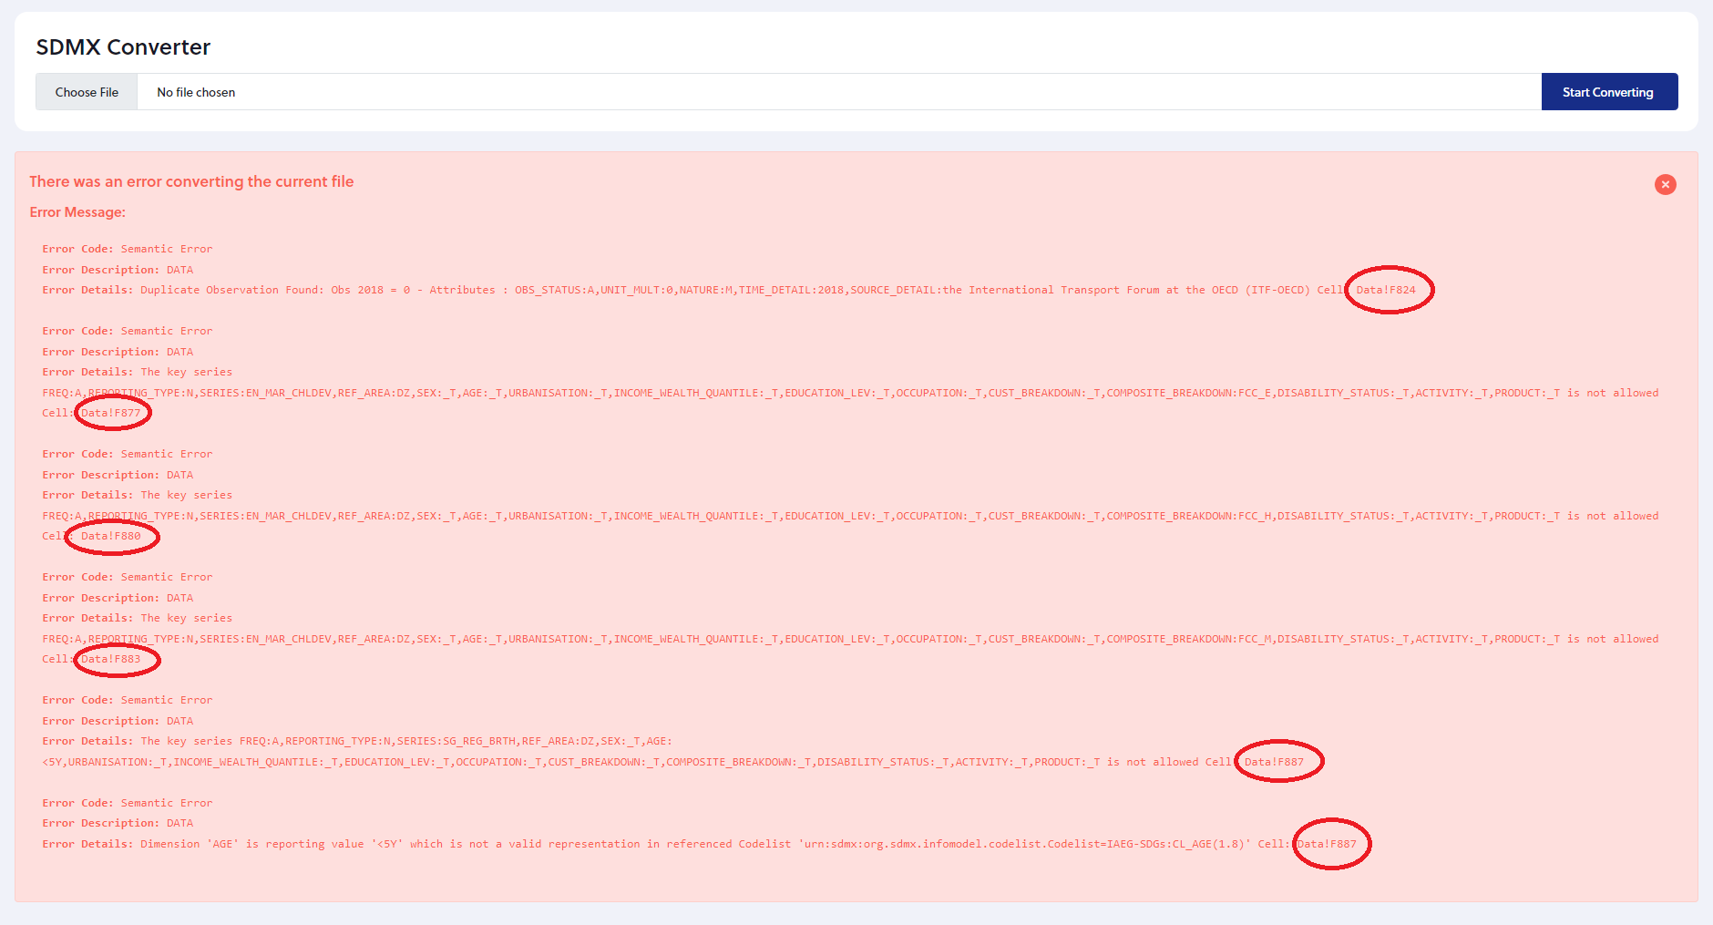
File Upload and Failed Conversion
In case there are errors in the file, a message stating details about each one, including the cell in the excel as highlighted, will appear on the screen.

Slide 15
SDMX Conversion & Transfer
Thank you
ICTS

