Slide 1
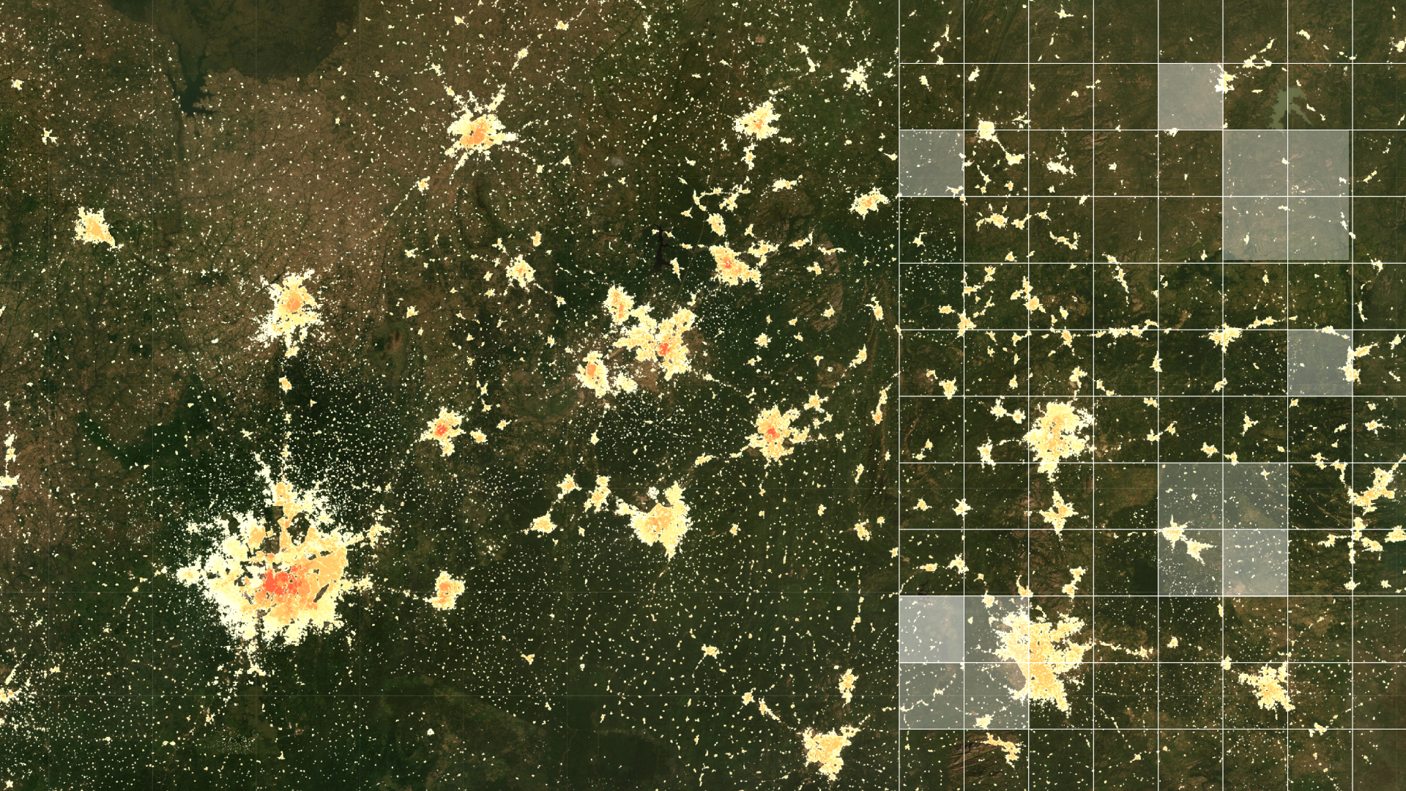
Technical workshop on geospatial population estimation for selected countries in the Arab Region
Day 3 – Revised Agenda
Notes:
Walk you through a relatively new and rapidly changing research field that has geography at its heart. It’s one that’s focussed on trying to improve the health and wellbeing of people everywhere – reducing inequalities and not leaving people behind.
This presentation provides an overview of geospatial methods, drawing on ‘big data’ and other sources, for complimenting traditional sources of demographic data in building evidence bases for monitoring progress towards the SDGs at subnational scales, and designing strategies. The examples come from work being undertaken by the WorldPop project (www.worldpop.org) and the Flowminder Foundation (www.flowminder.org), which both focus on improving the spatial demographic evidence bases for low and middle income countries, partnering with national statistical agencies, UN organizations, mobile network operators and data providers to add value to traditional datasources and integrate them with novel datasources to fill gaps.

Slide 2
Common areas of interest
Population estimation in inaccessible areas and where data is outdated
Estimating and mapping nomadic, displaced populations
Sample frames
Other interest areas: Building mapping, satellite imagery, urban definitions, training and skills

Slide 3
Revised agenda: Day 3
Geospatial methods and tools for sample frames
Short recap exercise
Building, settlement, urban mapping datasets
Group work in country teams with WorldPop/UNFPA input
Do any of the methods, applications discussed at the workshop look to be useful to your country?
If so, for what purpose? What data exist to support their application and where are there gaps?
Are there any specific deadlines, timelines that need to be met?
What capacity and skills exist already, and what training might be needed?

