Slide 1

Fourth Regional Workshop on Data and Metadata Exchange (SDMX) - Advanced Level II
Mapping and Converting SDG data with SDMX
Dos & Don’ts
Lebanon-Beirut
28 June 2022
Notes:
Rabih El Habta
Economist
Team Assistant - UN-ESCWA, Cluster 4- Statistics, Information Society & Technology Cluster

Slide 2
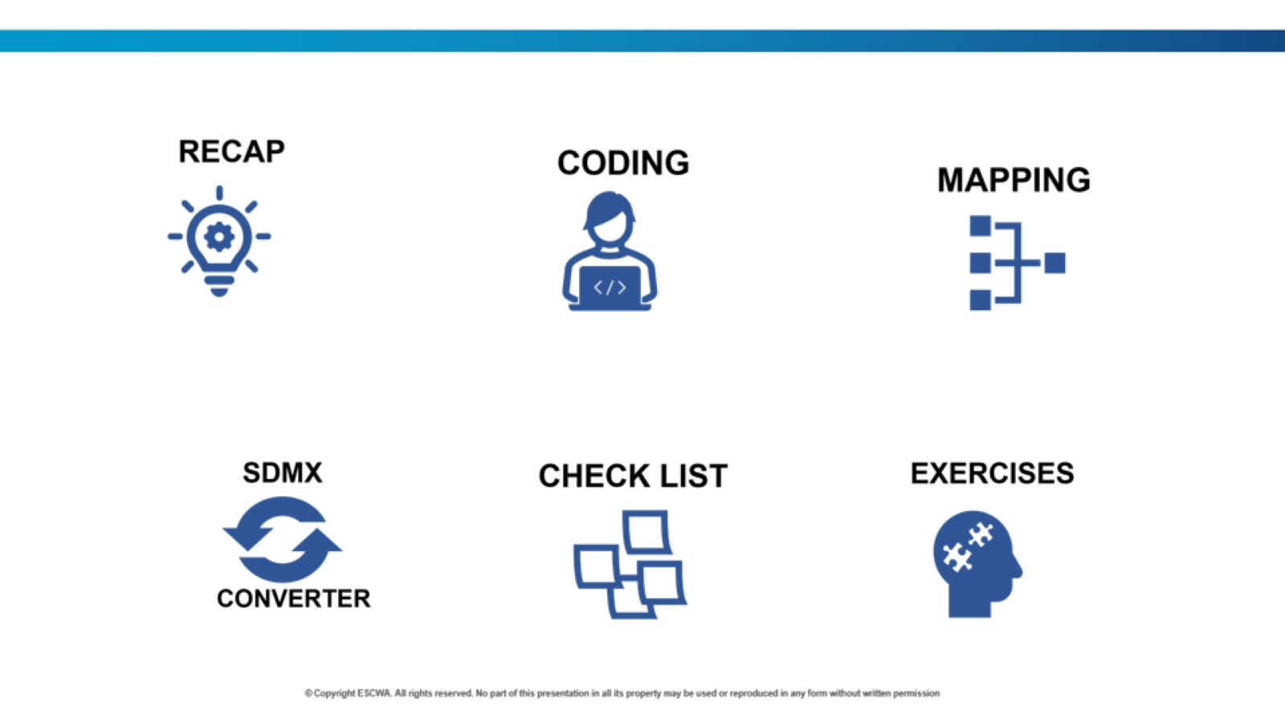

Slide 3
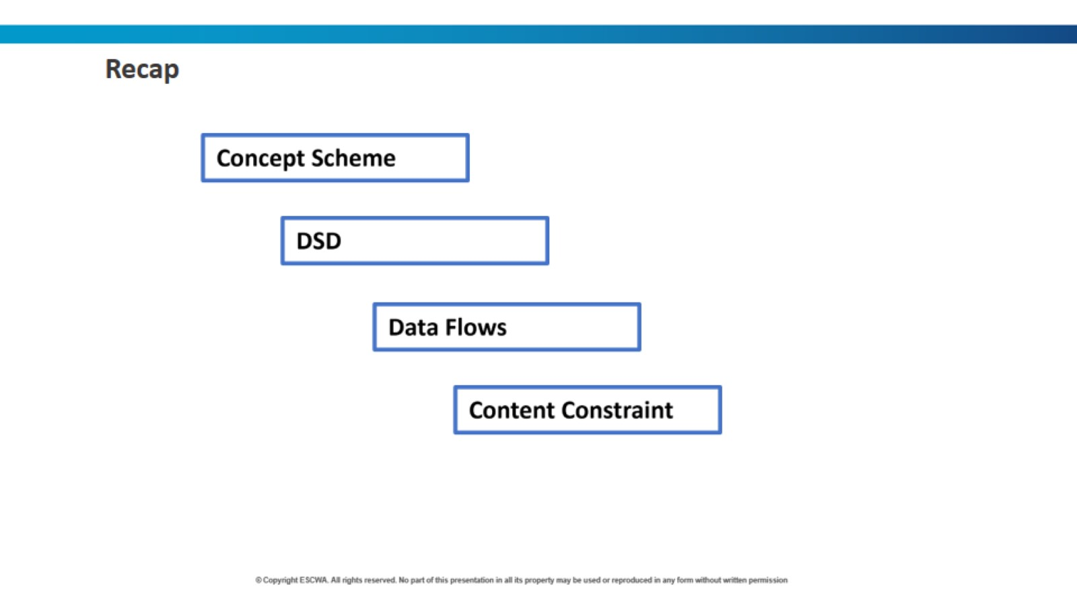

Slide 4
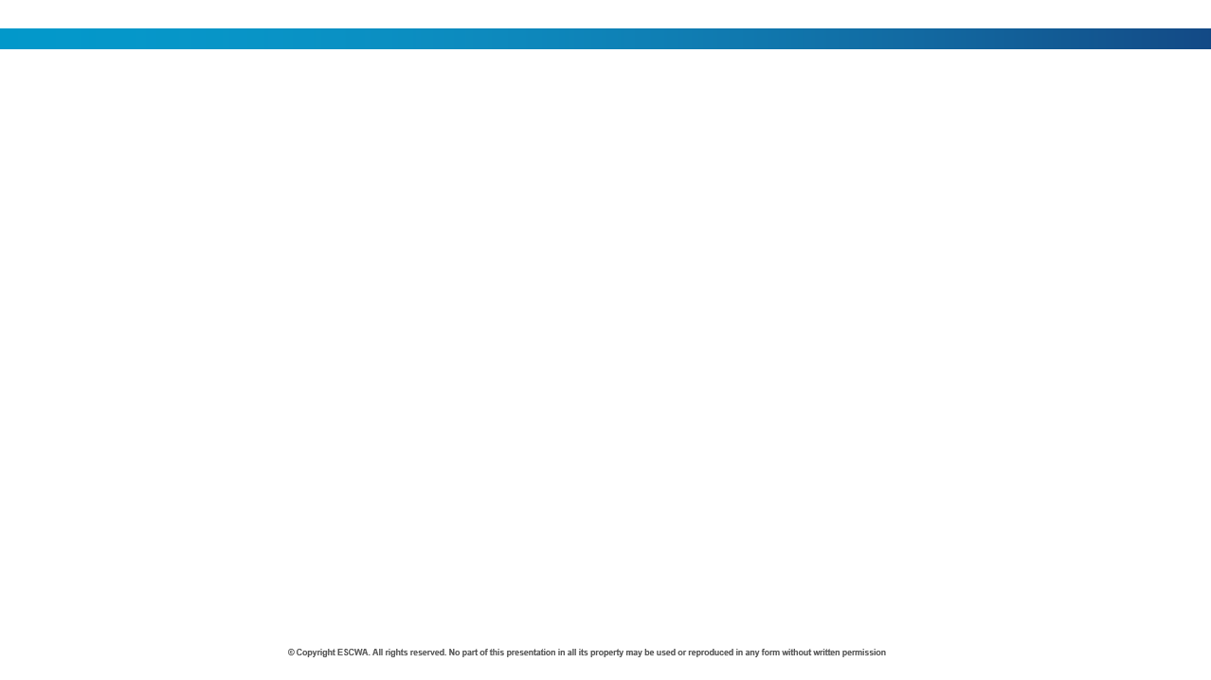

SDMX Data Cube Model
Each data point is characterised by:
Primary Measure
Observed values on one or more variables of interest.
Dimensions
A set of uniquely identifying characteristics.
Attributes
A set of additional characteristics that further describe it.
In SDMX, the data model is represented by a Data Structure Definition (DSD)

Slide 5
SDMX Concept Scheme
In SDMX, each dimension, measure and attribute encapsulates a concept.
The Set of Concepts that are used in a Data Structure Definition (DSD) or Metadata Structure Definition (MSD) is known as a Concepts Scheme.
Representation of a concept:
  Coded:
  Drawn from a code list* (for e.g., “country ISO code”), for example, AGE, SEX, URBANISATION, REF_AREA, NATURE, etc.
  Un-coded with a format:
  Required to adhere to a specific data format (e.g., “YYYY” for years), for example, TIME_PERIOD, DATA_LAST_UPDATE, BASE_PER, TIME_COVERAGE, etc.
  Required to be contained within a specific range of values (e.g., “numerical values between 0 and 1”) for example, OBS_VALUE, UPPER_BOUND, LOWER_BOUND.
  Un-coded free text:
  Drawn from a type of values (e.g., “text”), for example, SOURCE_DETAIL, COMMENT_OBS, COMMENT_TS, CUST_BREAKDOWN_LB, TIME_DETAIL$ etc.
A predefined list from which some statistical coded concepts take their values.
$ It can be a date, also a footnote, e.g., "Survey ran from 1 Jul 2021 - 30 Jun 2022"

Slide 6
Data Structure Definition (DSD)
Concept Scheme
Reference
DSD
Reference
Code lists
Concept | Concept ID | Role | Attachment | Representation | Code list ID
Indicator | INDICATOR | Dimension |  | Code List | CL_INDICATOR
Reference area | REF_AREA | Dimension |  | Code List | CL_REF_AREA
Time period | TIME_PERIOD | Dimension |  | YYYY
Unit multiplier | UNIT_MULT | Attribute | Time series | Code List | CL_UNIT_MULT
⁞ | ⁞ | ⁞ | ⁞ | ⁞ | ⁞
Obs. value | OBS_VALUE | Pr. Measure |  | Number
Notes:
NOTES:
1- A concept scheme places concepts into a maintainable unit, where each concept has a concept ID in uppercase letters.
2- Code list identifier is (CL_), in uppercase letters.

Slide 7

Data Structure Definition (DSD) (2)
The global SDG DSD has 32 concepts, including 16 dimensions, 15 attributes, and the primary measure.
These include 2 “wildcard” (multi-purpose) dimensions, COMPOSITE_BREAKDOWN and CUST_BREAKDOWN, which can be used to support multiple breakdowns.
The multi-purpose dimensions play a key role in the customization of the DSD.
Dimensions |  |  | Attributes
FREQ | URBANISATION | SEX | OBS_STATUS | TIME_COVERAGE | GEO_INFO_URL
REPORTING_TYPE | EDUCATION_LEV | AGE | UNIT_MEASURE | COMMENT_OBS | GEO_INFO_TYPE
REF_AREA | COMPOSITE_BREAKDOWN | ACTIVITY | UNIT_MULT | COMMENT_TS | CUST_BREAKDOWN_LB
SERIES | CUST_BREAKDOWN | PRODUCT | SOURCE_DETAIL | UPPER_BOUND
TIME_PERIOD | INCOME_WEALTH_QUALNTILE |  | TIME_DETAIL | LOWER_BOUND
OCCUPATION | DISABILITY_STATUS |  | BASE_PER | DATA_LAST_UPDATE
The code lists for SDMX SDG DSD concepts, are available in the SDG_DSD_MATRIX.xlsm excel macro file.
Notes:
Notes:
0-Highlighted yellow are the mandatory attributes, i.e., use of SKIP is not allowed.
1-Composite breakdown Note: can’t join two dimensions into 1 breakdown.
2-COMPOSITE_BREAKDOWN: is a mixed dimension, it represents several merged code lists e.g., by International Organizations, Hazard Type etc.// Used for breakdowns that are only used in 1 or 2 indicators, in order to avoid creating too many dimensions // Use _T if not applicable.
3-Special dimension introduced to facilitate non-standard breakdowns, primarily in the national context. Populated with generic codes. // Data providers assign meaning to their own context. // Used in conjunction with attribute CUST_BREAKDOWN_LB, which transmits a description of the custom code. // Use _T if not applicable
4-Attribute COMMENT_OBS (details on specific aspects of each observation, such as how the observation was computed/estimated) is used for observation-level footnotes and COMMENT_TS (details that could affect the comparability of this data point with others in a time series) for time series-level footnotes. //Both are optional.
5-Upper & Lower bounds: Where the observation value represents a point estimate, can be used to convey the Upper and Lower bounds. // In MDG DSD, separate series codes had to be created for upper and lower bounds
6-Base Period: Period of time used as the base of an index number, or to which a constant series refers // Where a base period applies, it is expected to always be set to a year // Typically, used for constant prices, as in “2005 USD dollar”
7-Provides web address of a geoinformation file. // Used in conjunction with attribute GEO_INFO_TYPE (Specifies type of geoinformation file provided in attribute).

Slide 8
SDMX Dataflows (DF)
Dataflow defines a “view” on a Data Structure Definition (DSD).
It is a structure that can help describe, categorize and constrain datasets.
Each data flow is linked to one DSD.
Each DSD may have one or more dataflows linked to it.
In its simplest form defines any data valid according to a DSD.
SDG Global Dataflows (DF)
DF_SDG_GLH – Harmonized Global Dataflow. This data flow is used by the Custodian Agencies to report SDG indicators that are part of the global dataset, regardless of how the data was obtained.
DF_SDG_GLC – Country Global Dataflow. This data is used by countries to report data to UNSD and ESCWA, as well as to disseminate national data in compliance with the SDG Global DSD.

Slide 9
SDMX Content Constraints (CN)
Content constraints define restrictions on code lists or series, it can be used to define which combinations of codes are allowed:
  For example, SERIES= “ Proportion of Women in National Parliament “ → SEX must be “FEMALE”
Constraints can define more granular validation rules than a simple validation of codes.
Are often attached to the Dataflow but can also be attached to DSD, but wherever content constraints are attached, code lists that they restrict are defined in the underlying DSD.
Types of SDMX Content Constraints (CN)
Cube Region: Define allowed (or disallowed) codes from DSD code lists.
Series: Define allowed (or disallowed) combinations of codes from DSD code lists.

Slide 10
SDG Cube Region Content Constraints (CN)
CN_SDG_GLC, attached to dataflow DF_SDG_GLC:
  Restricts the dimension REPORTING_TYPE to code N (“National”).
CN_SDG_GLH, attached to dataflow DF_SDG_GLH:
  Restricts the dimension REPORTING_TYPE to code G (“Global”).
SDG Cube Series Content Constraints (CN)
CN_SERIES_SDG_GLC, attached to dataflow DF_SDG_GLC
CN_SERIES_SDG_GLH, attached to dataflow DF_SDG_GLH
The Data Structure Definition (DSD), Data Flows (DF) and the Series of Content Constraints (CN) can be downloaded from:
  The SDMX Global Registry or SDMX-SDG page.

Slide 11
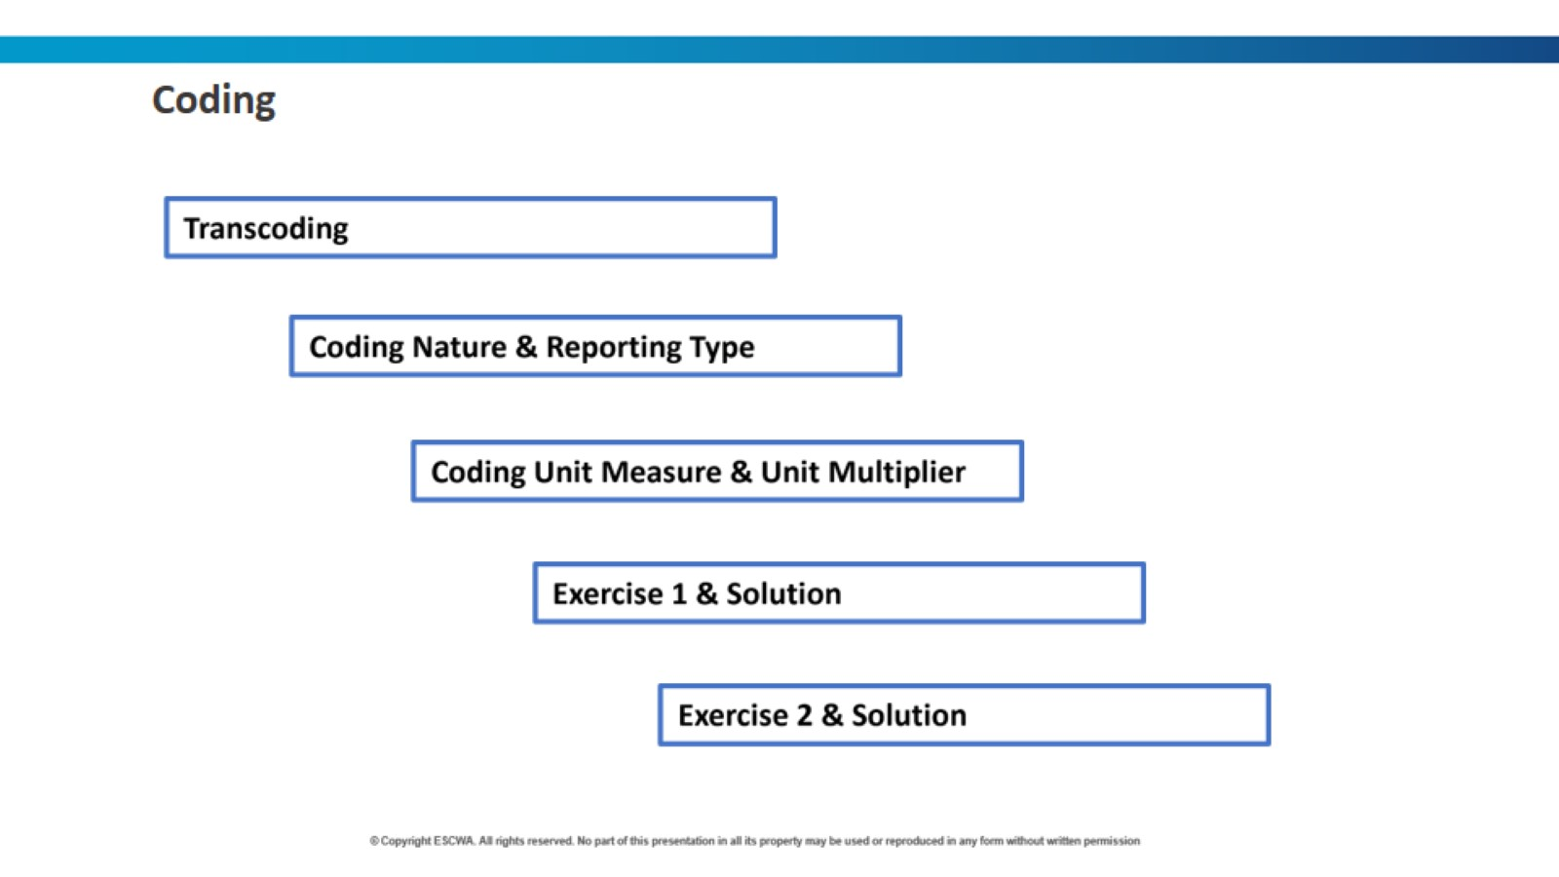

Slide 12

Transcoding
Transcoding refers to code mapping when internal codes are different from DSD codes.
For conversion to work, internal codes need to be replaced with DSD codes.
Transcoding can also be stored in external files. This is very useful when multiple sheets need to be mapped and reused.
The use of a single code for no breakdown (e.g., for Total and Not Applicable) simplifies the mappings.
Inconsistent mappings and transcoding lead to duplications and other anomalies.

Slide 13
Coding Nature & Reporting Type
Do the coding for the following scenarios:
S1- You have in the dataset data retrieved from the global database with nature “Country Adjusted”, what would you expect in the attribute NATURE, and the REPORTING_TYPE?
S2- You have in the National data retrieved from the MICS report, how would you code the attribute NATURE, and the REPORTING_TYPE?
For the two scenarios above, you are using the dataflow to convert the data, which dataflow you should use for each scenario?

Slide 14
Coding Nature & Reporting Type – solution
Do the coding for the following scenarios:
S1- You have in the dataset data retrieved from the global database with nature “Country Adjusted”, what would you expect in the attribute NATURE, and the REPORTING_TYPE?
  Answer: REPORTING_TYPE: G || NATURE: CA
S2- You have in the National data retrieved from the MICS report, how would you code the attribute NATURE, and the REPORTING_TYPE?
  Answer: REPORTING_TYPE: N || NATURE: C
For the two scenarios above, you are using the dataflow to convert the data, which dataflow you should use for each scenario?
  Answer: S1-DF_SDG_GLH || S2- DF_SDG_GLC
Notes:
If there are any adjustments to the official metadata, it should be reflected in attribute comment_obs.

Slide 15
Coding Unit Measure & Unit Multiplier
series | indicator | UNIT_MEASURE | UNIT_MULT
SI_POV_DAY1 | [1.1.1] Proportion of population below international poverty line (%)
SN_ITK_DEFCN | [2.1.1] Number of undernourished people, thousands
AG_PRD_XSUBDY | [2.b.1] Agricultural export subsidies, billion USD dollars
SH_STA_MORT | [3.1.1] Maternal mortality ratio, per 100,000 live births
SH_STA_TRAF | [3.6.1] Death rate due to road traffic injuries, per 100,000 population
SH_ACS_UNHC | [3.8.1] Universal health coverage (UHC) service coverage index
EN_WBE_PMNR | [6.6.1] Water body extent (permanent) (square kilometres)
EN_ATM_CO2 | [9.4.1] Carbon dioxide emissions from fuel combustion, in million tones
GB_POP_SCIERD | [9.5.2] Researchers (in full-time equivalent) per million inhabitants
EN_LND_CNSPOP | [11.3.1] Ratio of land consumption rate to population growth rate
AG_LND_TOTL | [15.1.1] Land area (thousands hectares)
GR_G14_XDC | [17.1.1] Total government revenue, in trillion local currency
IT_USE_II99 | [17.8.1] Internet users per 100 inhabitants

Slide 16
Coding Unit Measure & Unit Multiplier – solution
series | indicator | UNIT_MEASURE | UNIT_MULT
SI_POV_DAY1 | [1.1.1] Proportion of population below international poverty line (%) | PT | 0
SN_ITK_DEFCN | [2.1.1] Number of undernourished people, thousands | NUMBER | 3
AG_PRD_XSUBDY | [2.b.1] Agricultural export subsidies, billion USD dollars | USD | 9
SH_STA_MORT | [3.1.1] Maternal mortality ratio, per 100,000 live births | PER_100000_LIVE_BIRTHS | 0
SH_STA_TRAF | [3.6.1] Death rate due to road traffic injuries, per 100,000 population | PER_100000_POP | 0
SH_ACS_UNHC | [3.8.1] Universal health coverage (UHC) service coverage index | IX | 0
EN_WBE_PMNR | [6.6.1] Water body extent (permanent) (square kilometres) | KM2 | 0
EN_ATM_CO2 | [9.4.1] Carbon dioxide emissions from fuel combustion, in million tones | T | 6
GB_POP_SCIERD | [9.5.2] Researchers (in full-time equivalent) per million inhabitants | PER_1000000_POP | 0
EN_LND_CNSPOP | [11.3.1] Ratio of land consumption rate to population growth rate | RO | 0
AG_LND_TOTL | [15.1.1] Land area (thousands hectares) | HA | 3
GR_G14_XDC | [17.1.1] Total government revenue, in trillion local currency | CUR_LCU | 12
IT_USE_II99 | [17.8.1] Internet users per 100 inhabitants | PER_100_POP | 0

Slide 17
Exercise (1)
indicator | series | age | sex | locat* | educat* | activity | quantile | comp_break* | unit_measure | mult.
[2.2.1] Number of children stunted (thousands) | SH_STA_STNT | Y0T5 | _T | _T | _T | _T | _T | _T | NUMBER | 0
[4.1.1] Children in secondary school achieving a minimum level in reading (%) | SE_TOT_PRFL | _T | _T | _T | ISCED11_2 | _T | _T | SKILL_READ | PERCENT | 0
[9.2.1] Manufacturing value added per capita (million constant USD) | NV_IND_MANF | _T | _T | _T | _T | ISIC_C | _T | _T | CON_USD | 0
[[3.2.1] Under-five mortality rate per 1,000 live births, female | SH_DYN_MORTN | 0T4Y | _F | _T | _T | _T | _T | _T | PER_1000_POP | 0
[3.2.1] Infant mortality rate per 1,000 live births, rural | SH_DYN_IMRT | Y1 | _T | _U | _T | _T | _T | _T | PER_1000_POP | 0
[3.2.1] Number of neonatal mortality, male urban | SH_DYN_NMRT | M0 | _M | _R | _T | _T | _T | _T | NUMBER | 0
[5.3.1] Urban women aged 20-24 years married before age 18 (%) | SP_DYN_MRBF15 | Y20T24 | _F | _T | _T | _T | _T | _T | PER_MARW_20T24Y | 0
[9.1.1] The rural population who live within 2 km of an all-season road (%) | SP_ROD_R2KM | _T | _T | _R | _T | _T | _T | _T | PERCENT | 0
[11.1.1] Urban population living in slums (number) | EN_LND_SLUM | _T | _T | _U | _T | _T | _T | _T | NUMBER | 0
[17.8.1] Users of the internet (256 kbps to 2 Mbps)per 100 inhabitants | IT_USE_ii99 | _T | _T | _T | _T | _T | _T | IS_2MT10M | PERCENT | 0

Slide 18
Exercise (1) - solution
indicator | series | age | sex | locat* | educat* | activity | quantile | comp_break* | unit_measure | mult.
[2.2.1] Number of children stunted (thousands) | SH_STA_STNTN | Y0T4 | _T | _T | _T | _T | _T | _T | NUMBER | 3
[4.1.1] Children in secondary school achieving a minimum level in reading (%) | SE_TOT_PRFL | _T | _T | _T | AGG_2_3 | _T | _T | SKILL_READ | PT | 0
[9.2.1] Manufacturing value added per capita (million constant USD) | NV_IND_MANFPC | _T | _T | _T | _T | ISIC4_C | _T | _T | CON_USD | 9
[3.2.1] Under-five mortality rate per 1,000 live births, female | SH_DYN_MORT | Y0T4 | F | _T | _T | _T | _T | _T | PER_1000_LIVE_BIRTHS | 0
[3.2.1] Infant mortality rate per 1,000 live births, rural | SH_DYN_IMRT | Y0 | _T | R | _T | _T | _T | _T | PER_1000_LIVE_BIRTHS | 0
[3.2.1] Number of neonatal mortality, male urban | SH_DYN_NMRTN | M0 | M | U | _T | _T | _T | _T | NUMBER | 0
[5.3.1] Urban women aged 20-24 years married before age 18 (%) | SP_DYN_MRBF18 | Y20T24 | F | U | _T | _T | _T | _T | PT | 0
[9.1.1] The rural population who live within 2 km of an all-season road (%) | SP_ROD_R2KM | _T | _T | R | _T | _T | _T | _T | PT | 0
[11.1.1] Urban population living in slums (number) | EN_LND_SLUMN | _T | _T | U | _T | _T | _T | _T | NUMBER | 0
[17.8.1] Users of the internet (256 kbps to 2 Mbps)per 100 inhabitants | IT_USE_II99 | _T | _T | _T | _T | _T | _T | IS_256KT2M | PER_100_POP | 0

Slide 19
Exercise (2)
indicator | series | age | sex | locat* | quantile | disability_status | comp_break* | unit_measure | mult.
[2.c.1] Countries recording moderately high food prices (%)
[4.6.1] Population achieving a fixed level of proficiency in writing a computer program in specialized languages (%)
[8.10.2] Account ownership at a financial institution, richest 60% ( age 25+) (%)
[1.1.1] Youth rural population below the international poverty line (%)
[1.3.1] Mothers with newborns receiving a maternity cash benefit (%)
[3.7.2] Adolescent birth rate per 1,000 women aged 15-19, urban
[7.1.1] Urban population with access to electricity (%)
[8.5.2] The unemployment rate, for male disabled youth in the rural area (%)
[15.1.1] Forest area (hectares)
[16.9.1] Rural children under 5 years of age with birth registered (%), female

Slide 20
Exercise (2) - solution
indicator | series | age | sex | locat* | quantile | disability_status | comp_break* | unit_measure | mult.
[2.c.1] Countries recording moderately high food prices (%) | AG_FPA_HMFP | _T | _T | _T | _T | _T | SPL_M | PT | 0
[4.6.1] Population achieving a fixed level of proficiency in writing a computer program in specialized languages (%) | SE_ADT_FUNS | _T | _T | _T | _T | _T | SKILL_ICTPRGM | PT | 0
[8.10.2] Account ownership at a financial institution, richest 60% ( age 25+) (%) | FB_BNK_ACCSS | Y_GE25 | _T | _T | R60 | _T | _T | PT | 0
[1.1.1] Youth rural population below the international poverty line (%) | SI_POV_DAY1 | Y14T25 | _T | R | _T | _T | _T | PT | 0
[1.3.1] Mothers with newborns receiving a maternity cash benefit (%) | SI_COV_MATNL | _T | F | _T | _T | _T | _T | PT | 0
[3.7.2] Adolescent birth rate per 1,000 women aged 15-19, urban | SP_DYN_ADKL | Y15T19 | F | U | _T | _T | _T | PER_1000_POP | 0
[7.1.1] Urban population with access to electricity (%) | EG_ACS_ELEC | _T | _T | U | _T | _T | _T | PT | 0
[8.5.2] The unemployment rate, for male disabled youth in the rural area (%) | SL_TLF_UEMDIS | Y14T25 | M | R | _T | PD | _T | PT | 0
[15.1.1] Forest area (hectares) | AG_LND_FRSTN | _T | _T | _T | _T | _T | _T | HA | 3
[16.9.1] Rural children under 5 years of age with birth registered (%), female | SG_REG_BRTH | Y0T4 | F | R | _T | _T | _T | PT | 0

Slide 21
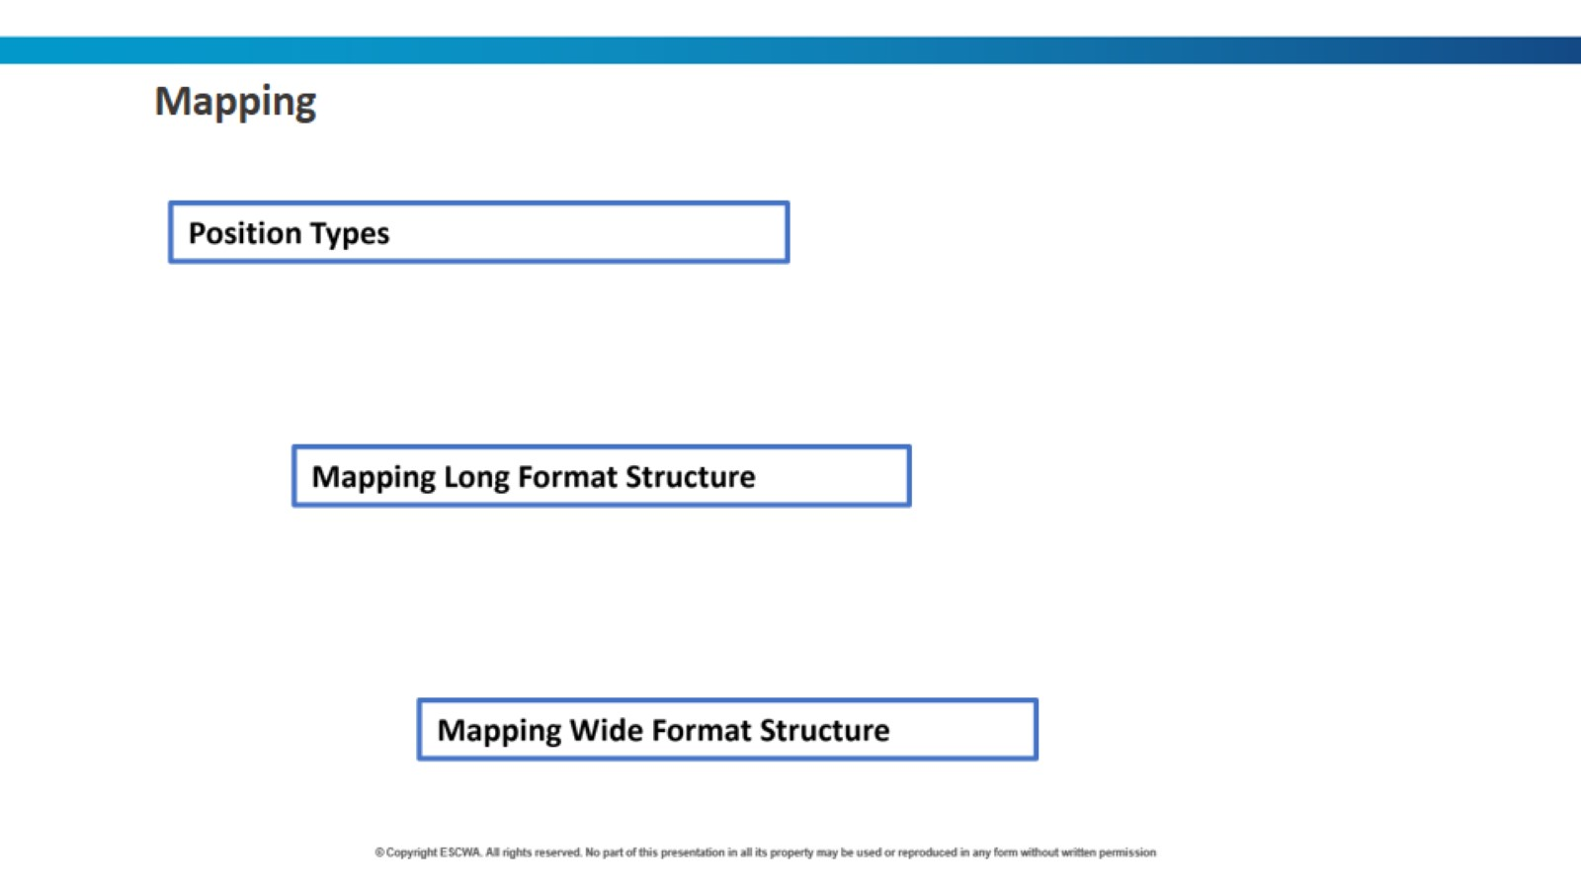

Slide 22
Mapping and Position Types
SDMX supports the following position types:
  COLUMN: When value for the entire dataset is provided in the cell provided in the column Position.
  ROW: Values for the concept are stored in the row specified in column Position
  FIX: Fixed value for the entire dataset is stored in the column Position and does not appear in the data spreadsheet
  MIXED: Allows to use two types of mapping interchangeably, reducing burden do the transcoding for all dataset.
  SKIP: The concept value is not mapped, it can only be used with optional attributes*, it can’t be used for dimensions.
* Mandatory Attributes are : OBS_STATUS, UNIT_MEASURE, UNIT_MULT.
Notes:
Note: There are also CELL and OBS_LEVEL position types mappings.

Slide 23
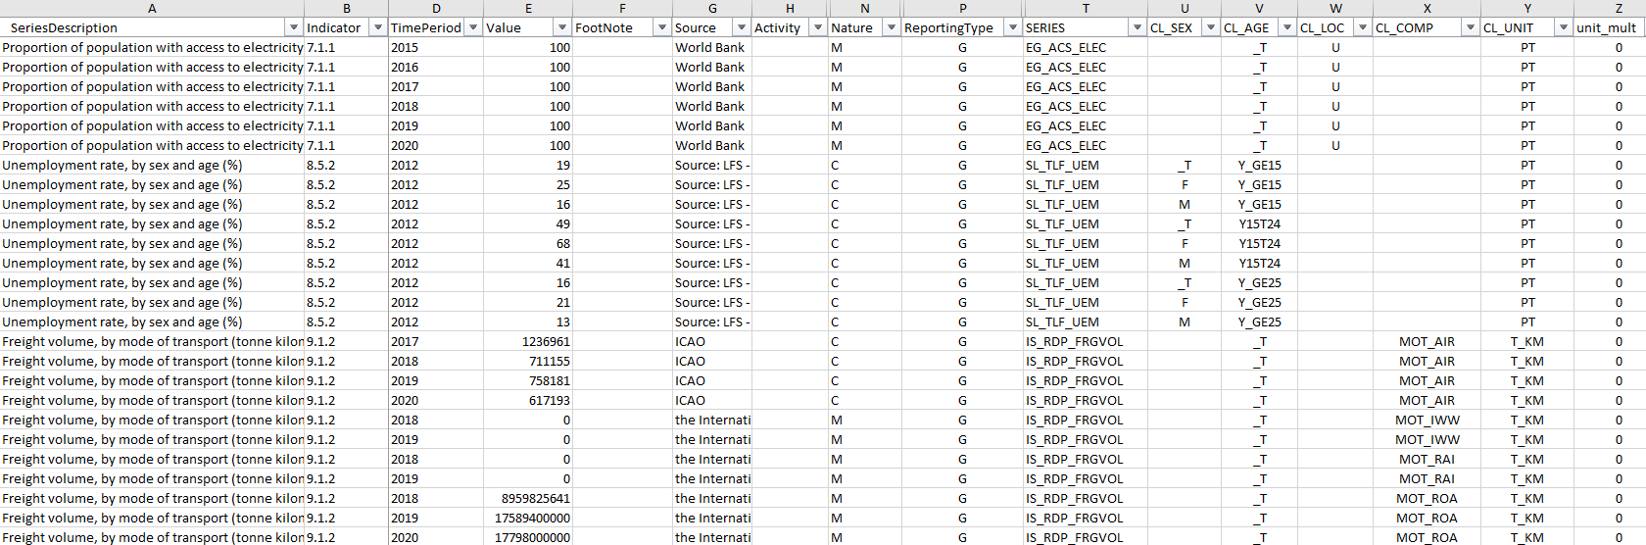
Data presentation types (wide “cross-tab” vs long “time series”)
Long “time series” format

Slide 24
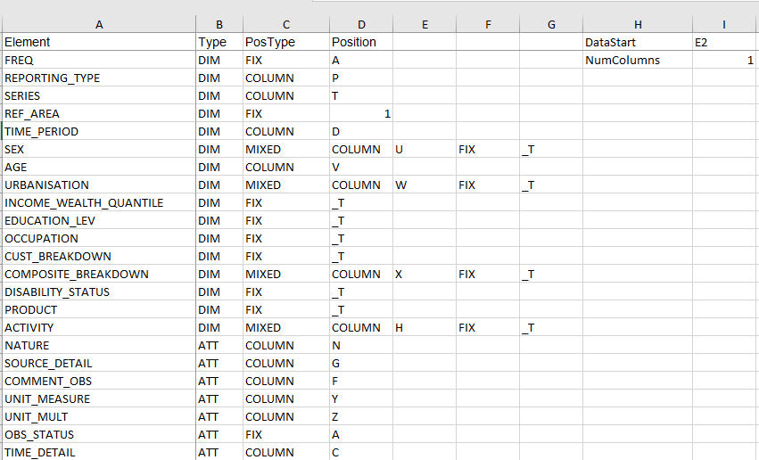
Mapping with Column letters
Notes:
Which data flow should be used here?

Slide 25
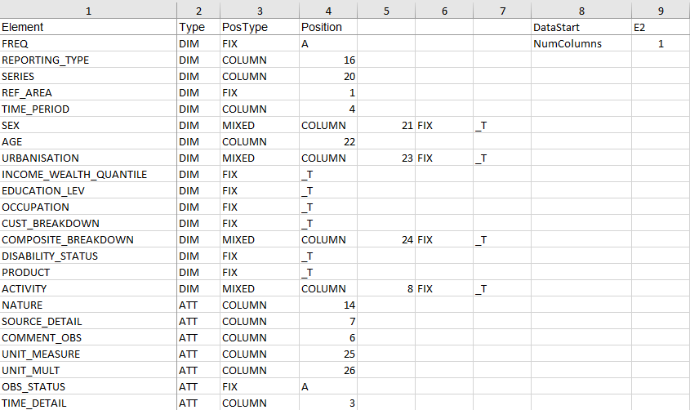
Mapping with Column numbers

Slide 26
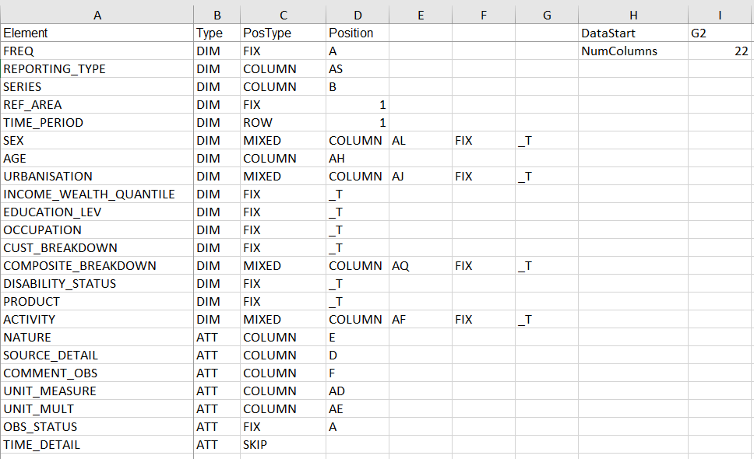
Wide “cross-tab” format

Slide 27
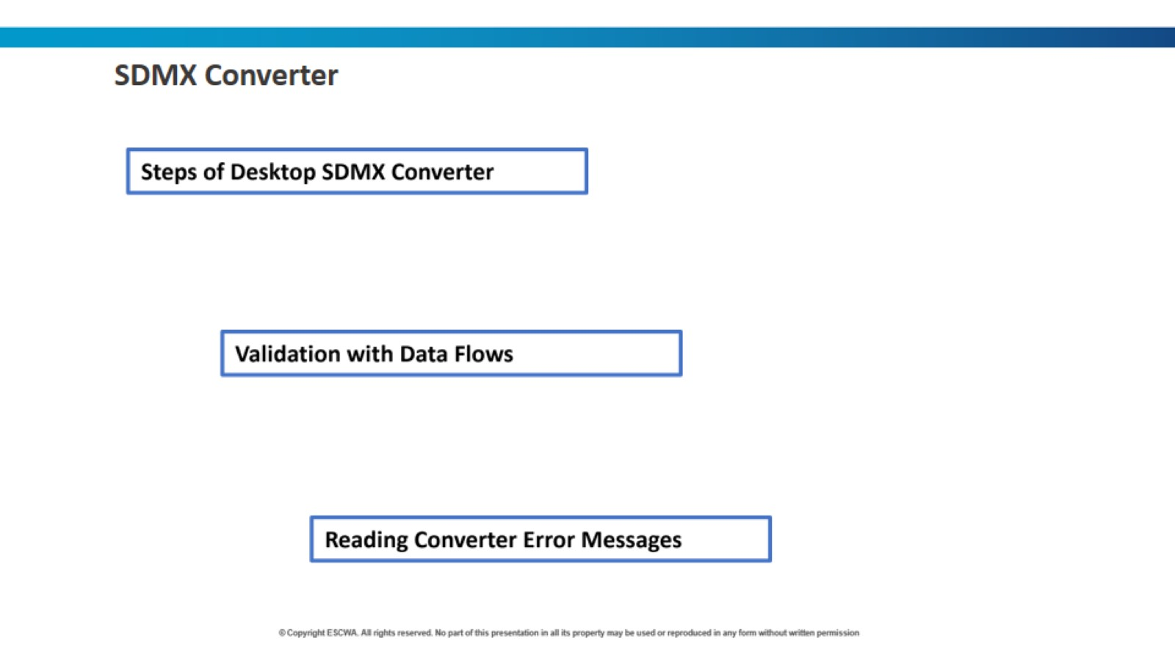

Slide 28
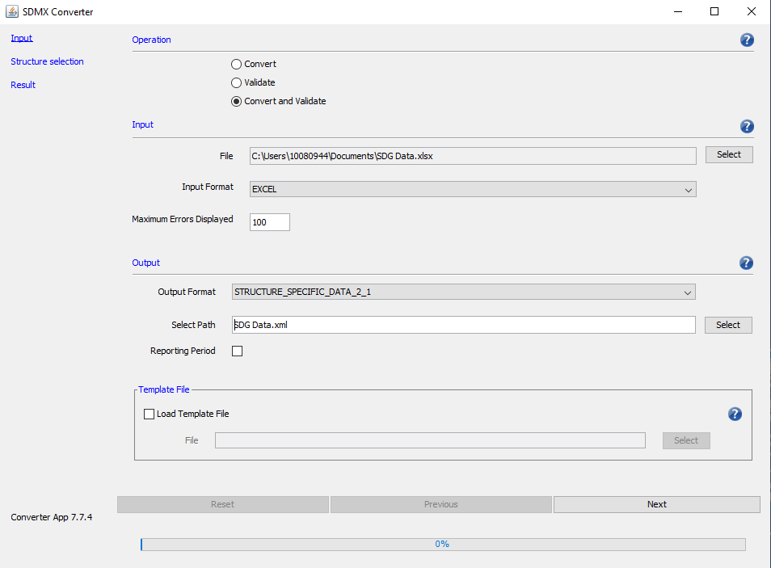
Using the Desktop-Based SDMX Converter
1. Select: Convert and Validate
2. Select the data file
3. Make sure the input format is Excel
4. Select output format: STRUCTURE_SPECIFIC_DATA_2_1
5. Enter the output file name .xml extension
6. Click Next
Notes:
Note: JAVA must be installed for the desktop converter

Slide 29
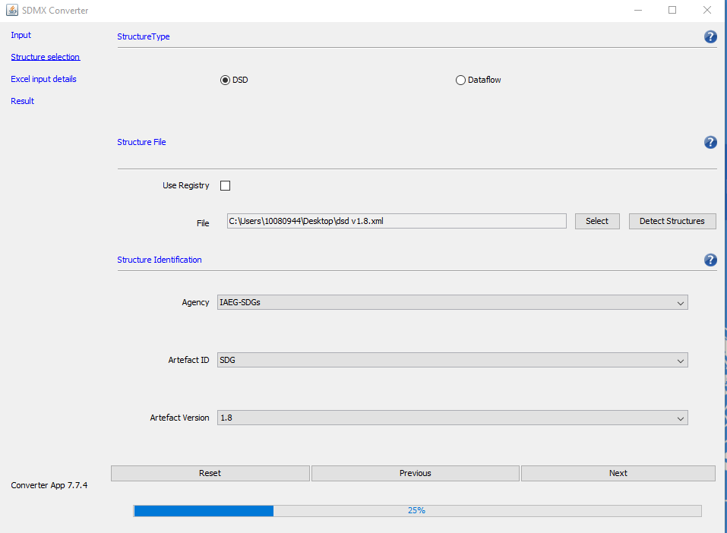
Using the Desktop-Based SDMX Converter (2)
7. Select: DSD or Dataflow
8. Select the DSD file
9. Click Next

Slide 30
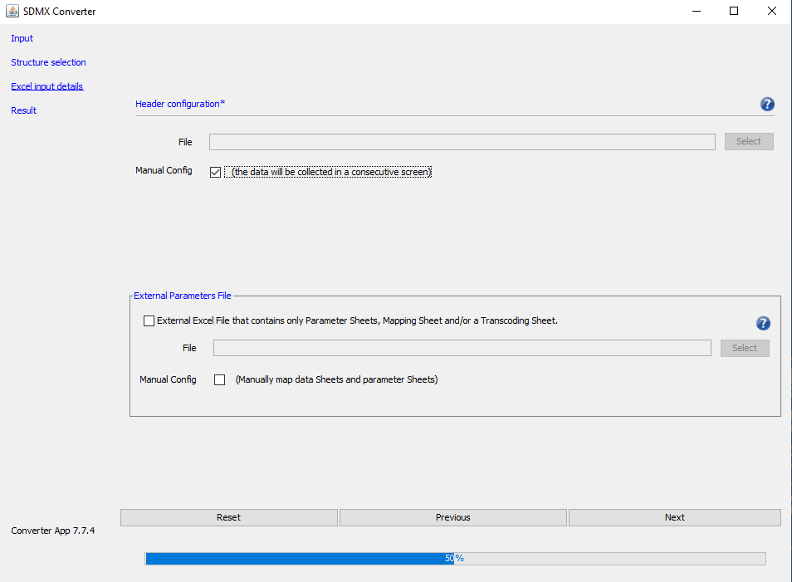
Using the Desktop-Based SDMX Converter (3)
10. Check Manual Config
11. Click Next

Slide 31
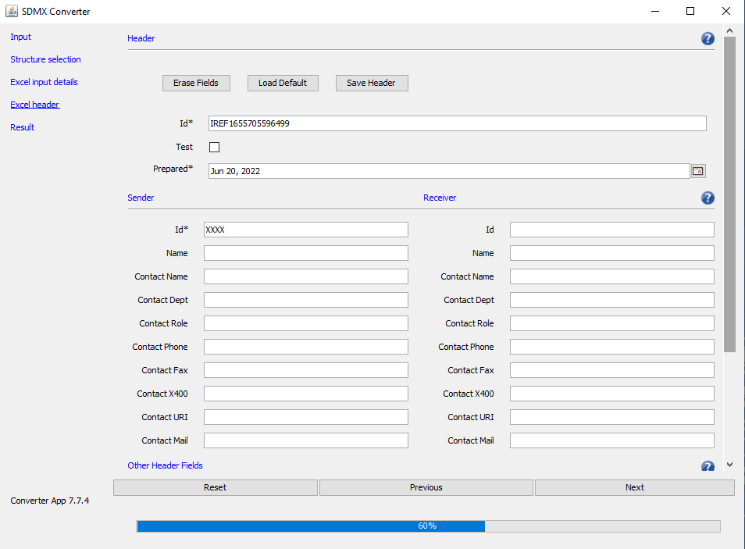
Using the Desktop-Based SDMX Converter (4)
12. Click Next

Slide 32
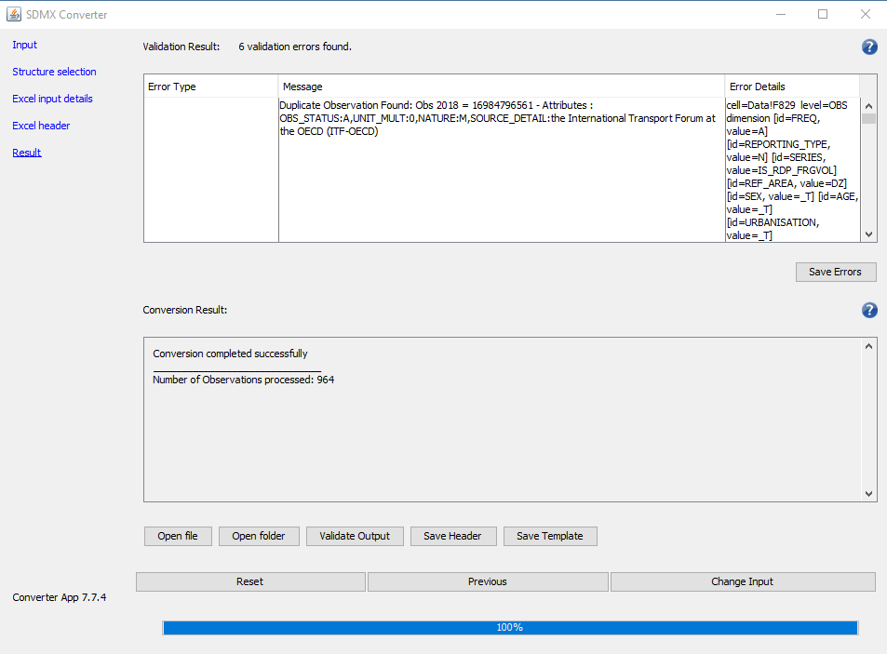
Using the Desktop-Based SDMX Converter (5)
13. Validate Results

Slide 33
Validation of SDG datasets
Validation against the DSD verifies that all dimensions and mandatory attributes are in place.
  Does not verify relationships between the dimension values. If you have the series “Forest area as a proportion of total land area” with Sex=Female, it will pass the validation.
Validation against a data flow, in addition, verifies relationships among dimension values.
  Will flag invalid combinations such as the above, gender indicators with Sex=Male, and similar coding errors.
  Helps validate the dataset before submitting it to the SDG Lab, which will reject invalid datasets.
Countries should always validate against dataflow DF_SDG_GLC for the data used by countries to report data to UNSD and ESCWA, as well as to disseminate national data in compliance with the SDG Global DSD.

Slide 34
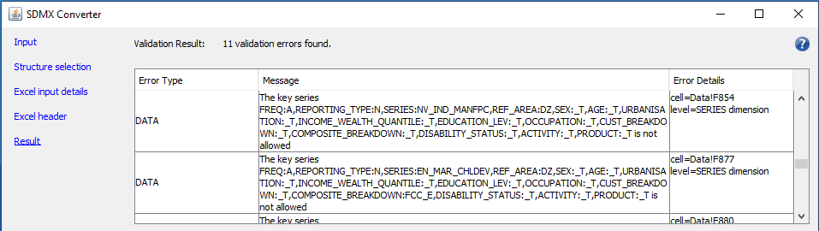
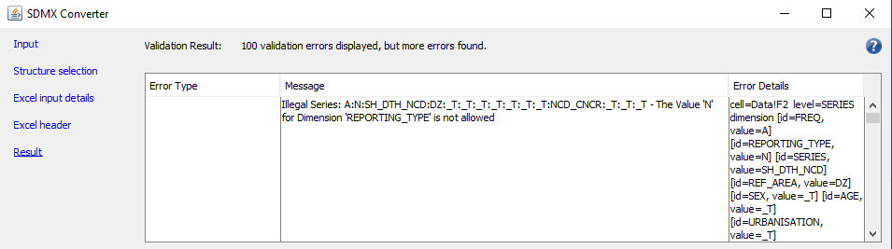
Interpreting SDMX Converter Error Messages - Types
Type 1:
Duplicate observation; could be the result of incorrect transcoding.
Type 2:
Use of invalid representation in a code list.
Type 3:
Not allowed specification i.e., the content constraint is not satisfied.
Type 4:
Illegal specification in dimension REPORTING_TYPE, i.e., the result of using wrong data flow for validation.
Type 5:
Incorrect or missing the mapping of parameters, such as wrong position or skipping a mandatory concept.
Validating Using DSD
Validating Using
DF_SDG_GLC
Validating Using
DF_SDG_GLH
Notes:
Note: Converter displays a maximum of 100 errors, yet more errors can be found.

Slide 35
Dos & Don’ts
Map internal code lists to DSD code lists.
Preferably store transcoded codes in external files.
Familiarity with the SDG DSD code lists.
Familiarity with SDG Content Constraint.
Avoid adding unnecessary columns, if they can be mapped using FIX as the type of the position.
Check if the attribute UNIT_MULT is specified correctly.
Validate against dataflow DF_SDG_GLC → REPORTING_TYPE= N.
Review SDMX converter error messages and correct them, until you get no error.
Review your coding and transcoding, even if the converter doesn’t report any error.
Practice, Practice, and Practice!

Slide 36
Useful Links
 | Link
Java | https://java.com/en/download/
Desktop SDMX Converter | https://bit.ly/3CwdjiA
Europa SDMX Online Converter | https://bit.ly/3HA28cg
ESCWA - Series of SDMX Trainings | https://bit.ly/3y51Kzg
ESCWA - SDMX Crash Course I | https://bit.ly/3MZQ5Gc
ESCWA - SDMX Crash Course II | https://bit.ly/3xXnhse
SDMX Global Registry | https://registry.sdmx.org/overview.html
SDMX SDG Page | https://bit.ly/3zSWUX9
SDG Metadata Template | https://bit.ly/3N9B1ps
SDG Metadata SDMX Converter | https://bit.ly/39Fvmdc

Slide 37

Questions &
Groups Exercises!

Slide 38

Thank you

