Slide 1



Reference metadata
Photo by Markus Spiske, unsplash
Harumi Shibata Salazar
United Nations Statistics Division

Slide 2
Objectives and expected outcomes
Objectives:
  Understanding the importance of metadata and learn how to author SDG metadata using the SDMX template
Expected outcomes:
  Develop skills to prepare national SDG metadata following the SDMX template

Slide 3
Content
Introduction to metadata
  What is metadata?
  Types of metadata
SDG Metadata Structure Definition (MSD)
How to complete the template and convert in authoring tool
Exercise

Slide 4
What is metadata?

Slide 5
What is metadata?
“Data that describe other data” (https://www.bls.gov/osmr/research-papers/2000/pdf/st000040.pdf)
“Can be defined as information that is needed to be able to use and interpret statistics. Metadata describe data by giving definitions of populations, objects, variables, the methodology and quality” (https://ec.europa.eu/eurostat/statistics-explained/index.php?title=Glossary:Metadata)
“the range of information, generally textual, that fosters understanding of the context in which statistical data have been collected, processed and analysed with the objective of creating statistical information (legal and regulatory texts, methods and concepts used at all levels of information processing, definitions and nomenclatures, etc.)” (African Charter on Statistics https://au.int/sites/default/files/treaties/36412-treaty-african_charter_on_satistics_eng.pdf)

Slide 6
Examples of metadata

Slide 7
Examples of metadata
Data labels
Definitions
Descriptions of methodology
Legends
Source
Footnotes
Etc.

Slide 8
Importance of statistical metadata
Data make no sense when presented on their own.
Metadata provide the information needed to understand what data represent.
What?
Who?
Population estimate
Total population
10,203,693
Where?
When?
Cairo
1 January 2023
https://www.capmas.gov.eg/pdf/new_Pdf/20238713628_pop2023%20-%20e.pdf

Slide 9
Types of statistical metadata
Statistical Metadata
Data about statistical data
Structural metadata
Metadata that identify and describe data and reference metadata
SDMX Glossary version 2.1, December 2020

Slide 10
What is structural metadata?
Structural Metadata
Definition | Metadata that identify and describe data and reference metadata.
Context | Structural metadata are needed to identify, use, and process data matrixes and data cubes, e.g. names of columns or Dimensions of statistical cubes. Structural metadata must be associated with the statistical data and reference metadata, otherwise it becomes impossible to identify, retrieve and navigate the data or reference metadata. In SDMX structural metadata are not limited to describing the structure of data and reference metadata. The structural metadata in SDMX include many of the other constructs to be found in the SDMX Information Model including data discovery, data and metadata Constraints (used for both data validation and data discovery), data and structure mapping, data and metadata reporting, statistical processes.
SDMX Glossary version 2.1, December 2020

Slide 11
What is structural metadata?
Structural metadata are used to identify statistical data such as titles, subtitles, short descriptions, dimension names or variable names.
Structural metadata include:
titles of the variables and dimensions of statistical datasets
units of measurement
code lists – for example, for area coding
data formats
potential value ranges
time dimensions
value ranges of flags
Data and structural metadata must go together!
https://ec.europa.eu/eurostat/web/metadata/overview

Slide 12
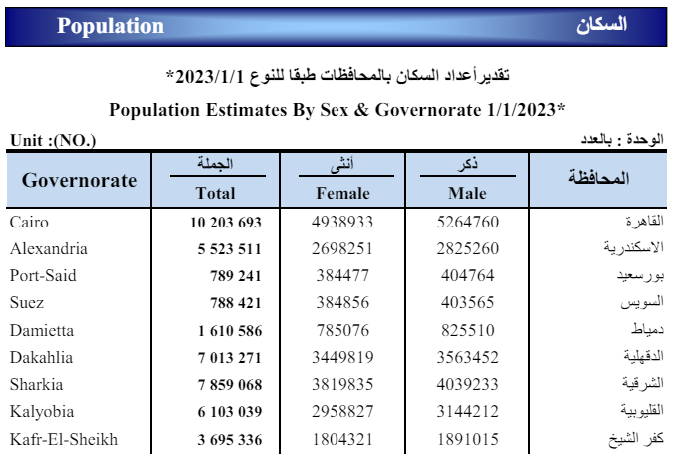
Structural metadata
Indicator
Reference Period
Unit
Geographic scope
https://www.capmas.gov.eg/pdf/new_Pdf/20238713628_pop2023%20-%20e.pdf

Slide 13
Structural metadata
https://www.capmas.gov.eg/Admin/News/PressRelease/20151110143133_955_e.pdf

Slide 14
Types of statistical metadata
Statistical Metadata
Data about statistical data
Structural metadata
Metadata that identify and describe data and reference metadata
Reference metadata
Metadata describing the contents and the quality of the statistical data
Conceptual metadata
Metadata describing the concepts used and their practical implementation, allowing users to understand what the statistics are measuring and, thus, their fitness for use
Methodological metadata
Metadata describing methods used for the generation of the data (e.g. sampling, collection methods, editing processes)
Quality metadata
Metadata describing the different quality dimensions of the resulting statistics (e.g. timeliness, accuracy)
SDMX Glossary version 2.1, December 2020

Slide 15
What is reference metadata?
Reference metadata
Definition | Metadata describing the contents and the quality of the statistical data.
Context | Preferably, reference metadata should include all of the following: "conceptual" metadata, describing the concepts used and their practical implementation, allowing users to understand what the statistics are measuring and, thus, their fitness for use; "methodological" metadata, describing methods used for the generation of the data (e.g. sampling, collection methods, editing processes); and "quality" metadata, describing the different quality dimensions of the resulting statistics (e.g. timeliness, accuracy). Note that (a) does not define the actual structure of a Data Set in terms of concepts used, their representation, and role (Dimensions, Attributes, Measures) in a data structure. These metadata are referred to as Structural Metadata.
SDMX Glossary version 2.1, December 2020

Slide 16
What is reference metadata?
Reference metadata describe statistical concepts and methodologies used for the collection and generation of data. They provide information on data quality and, since they are strongly content-oriented, assist users in interpreting the data.
Reference metadata, unlike structural metadata, can be decoupled from the data. This means that they can be generated, collected, or disseminated separately from the statistics to which they refer. They can also be associated with different levels of data, such as with entire collections, datasets from a given country, or a single data item concerning 1 country and 1 year.
https://ec.europa.eu/eurostat/web/metadata/overview

Slide 17
Hierarchical way of viewing metadata
Structural metadata
Information describing the data is more detailed as one moves down from top of the pyramid
Reference metadata

Slide 18
Structural metadata
At the top of the pyramid is information essential for understanding the data
To explain the ‘basics’:
When, where, who and what?
This is translated to information about the:
  Indicator
  Reference period
  Source
  Geographic Scope
  Unit
Structural metadata
identifiers and descriptors of data

Slide 19
Conceptual reference metadata
Describes key concepts used and methodological elements
Explanatory notes and descriptive text which provide a good description of the statistics
Descriptions about:
  Definition
  Key concepts
  Standards and classifications
Conceptual
reference metadata

Slide 20
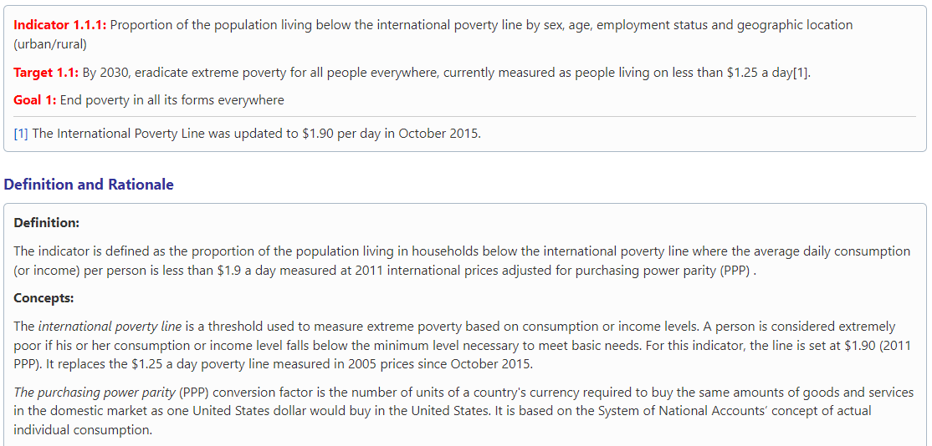
Conceptual reference metadata
Definitions
Key concepts
Standards and classifications

Slide 21
Detailed reference metadata on methods and quality
The most detailed methodological information available
Some statistical agencies publish very detailed concepts, sources and methods for a number of their key statistics
Include descriptions about:
  Process of collecting data
  Calculations
  Quality aspects
  Limitations of data
  Other detailed information
Detailed reference metadata

Slide 22
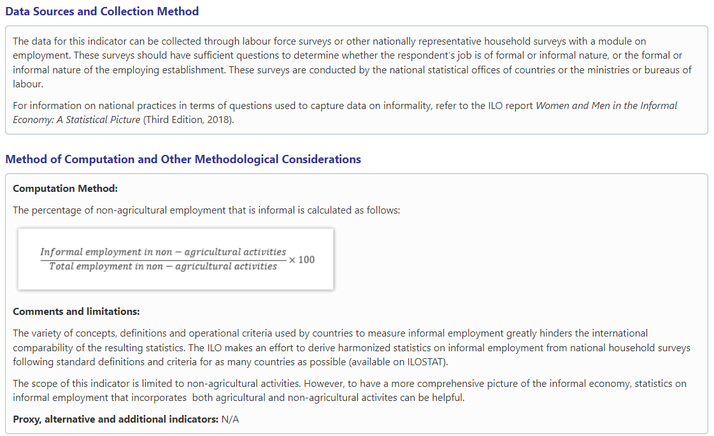
Detailed reference metadata on methods and quality
How are data collected?
How is the indicator calculated?
What are the limitations?

Slide 23

Metadata for the Global SDG Indicators

Slide 24
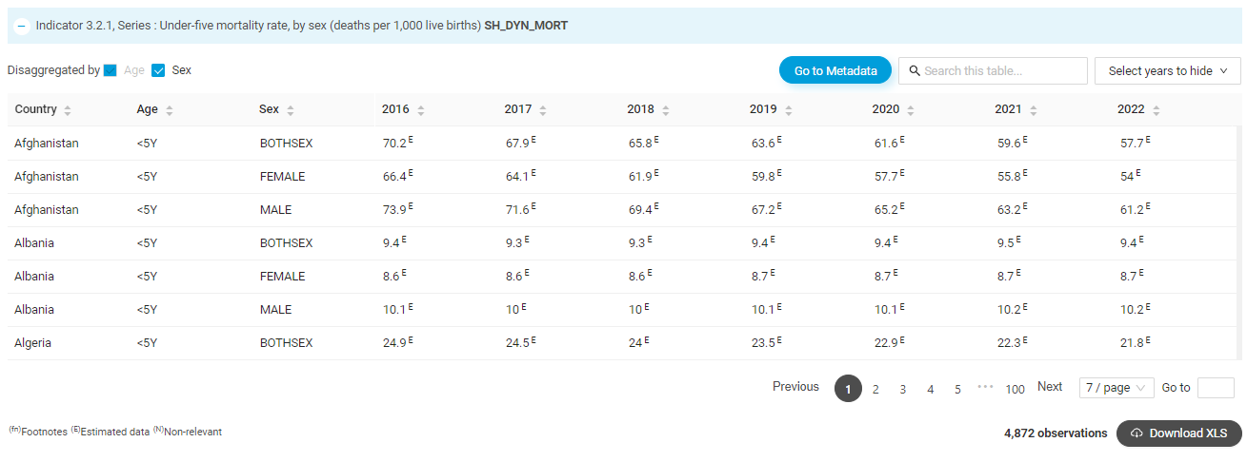
Global SDG Indicators Database: structural metadata
https://unstats.un.org/sdgs/dataportal/database

Slide 25
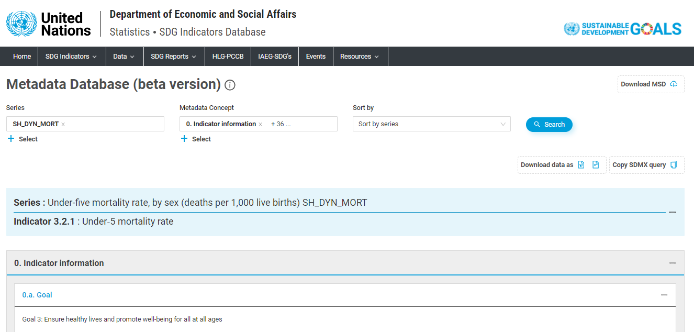
Metadata database
https://unstats.un.org/sdgs/dataportal/SDMXMetadataPage?3.2.1-SH_DYN_MORT

Slide 26
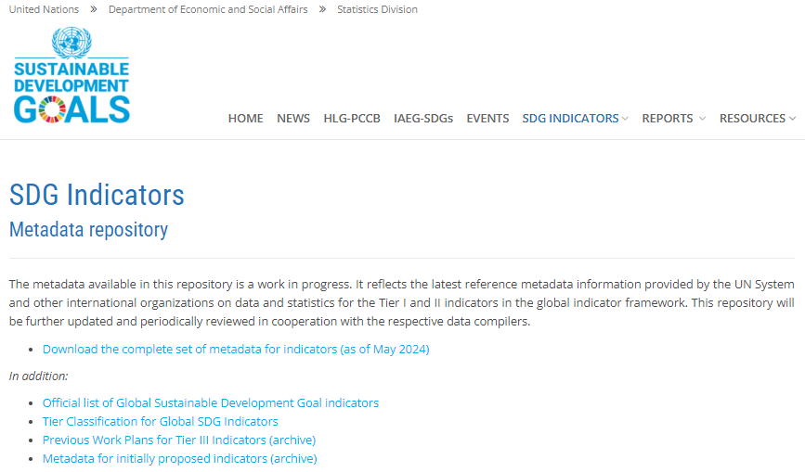
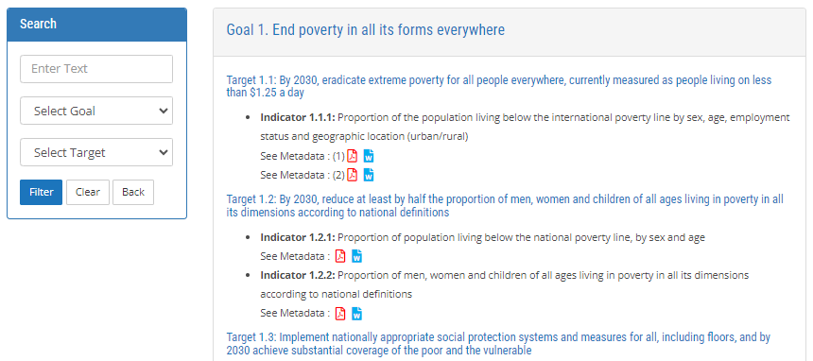
Global SDG Indicators Metadata Repository (Reference metadata)
https://unstats.un.org/sdgs/metadata/

Slide 27
Global SDG Reference Metadata
Defines the indicator and key concepts used in the definition of the indicator
Provides a rationale for why the associated indicator was included in the SDG indicator framework
Describes the data collection methodology, data sources, and calculation methodology used at the global level
Specifies any adjustments, aggregates, treatment of missing values, etc. at the global level
Explains the limitations and data quality considerations at the global level
Discusses data availability across countries

Slide 28
National SDG Reference Metadata
Specifies any national concept understandings and definitions that may differ from the global definition of the indicator
Describes the data collection methodology, data sources, and calculation methodology used in the country
Specifies any limitations, data quality considerations, etc. at the national level
Discusses data availability and disaggregations within the country
Provides contact information of the data reporter for clarification purposes
Specifies a national data release calendar

Slide 29
National metadata is essential for comparability
Increased demand for improved comparability
Within the same country
  E.g. looking at a series over time
At the global level
  E.g. looking at a series across countries
Differences arise from:
  use of different definitions, concepts, units and classifications;
  varying collection and processing (transformation) practices;
  diverse reporting and presentation practices

Slide 30
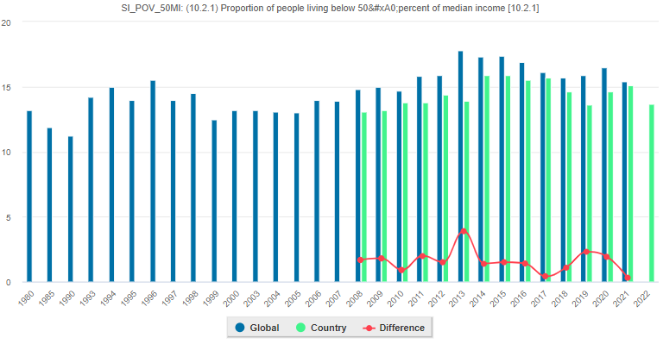
Discrepancies between global and national data
Proportion of people living below 50 percent of median income [10.2.1] (SI_POV_50MI)
Metadata is key to establishing methodology and quality as well as explaining differences between global and national datasets

Slide 31
Metadata
Metadata improves consistency and coherence
Metadata improves comparability
Metadata highlights data quality issues
Increased relevance

Slide 32
What is a Metadata Structure Definition - MSD?
Metadata Structure Definition, MSD
Definition | Specification of the allowed content of a Metadata Set in terms of attributes for which content is to be provided and to which type of object the metadata pertain.
Context | An MSD defines the reference metadata to be collected or reported by specifying the concepts required, how these relate to each other, their presentational structure and to which objects they are to be attached.
SDMX Glossary version 2.1, December 2020

Slide 33
Metadata Structure Definition for the SDGs
A draft metadata structure definition for the SDGs approved by the Working Group on SDMX for SDG Indicators of the Inter-Agency and Expert Group on SDG Indicators was released at the beginning of 2020.
The first official metadata structure definition for Sustainable Development Goal indicators was published in February 2022.

Slide 34
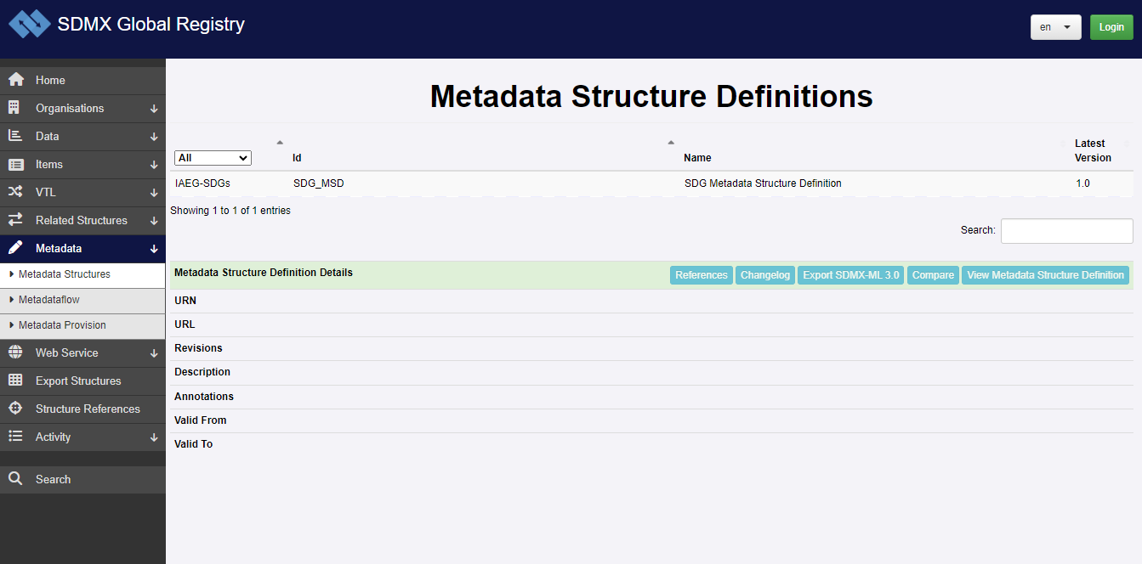
Metadata Structure Definition for the SDGs
https://registry.sdmx.org/metadata/metadatastructure.html

Slide 35
SDG metadata template
Standardized metadata improves usability and comparability
easier for users to interpret and lend themselves to machine readability and electronic exchange
use a common template for organizing metadata
improve comparability of data, both at the global level (between countries), and within countries – to understand comparability in time series over time

Slide 36
Metadata in SDMX
Can be stored or exchanged separately from the data object it describes, but be linked to it
Can be indexed and searched
Reported according to a structure defined by the Metadata Structure Definition (MSD)

Slide 37
SDG metadata template
The metadata template was approved by the SDG SDMX Working Group of the Inter-Agency and Expert Group on SDG Indicators (IAEG-SDGs)
Template for global metadata
Metadata template for national reporting (with country-specific instructions)
  Contains two main parts:
    Metadata attachment
    Metadata concepts
  Latest version can always be found in the GitHub repository: https://github.com/sdmx-sdgs/metadata

Slide 38
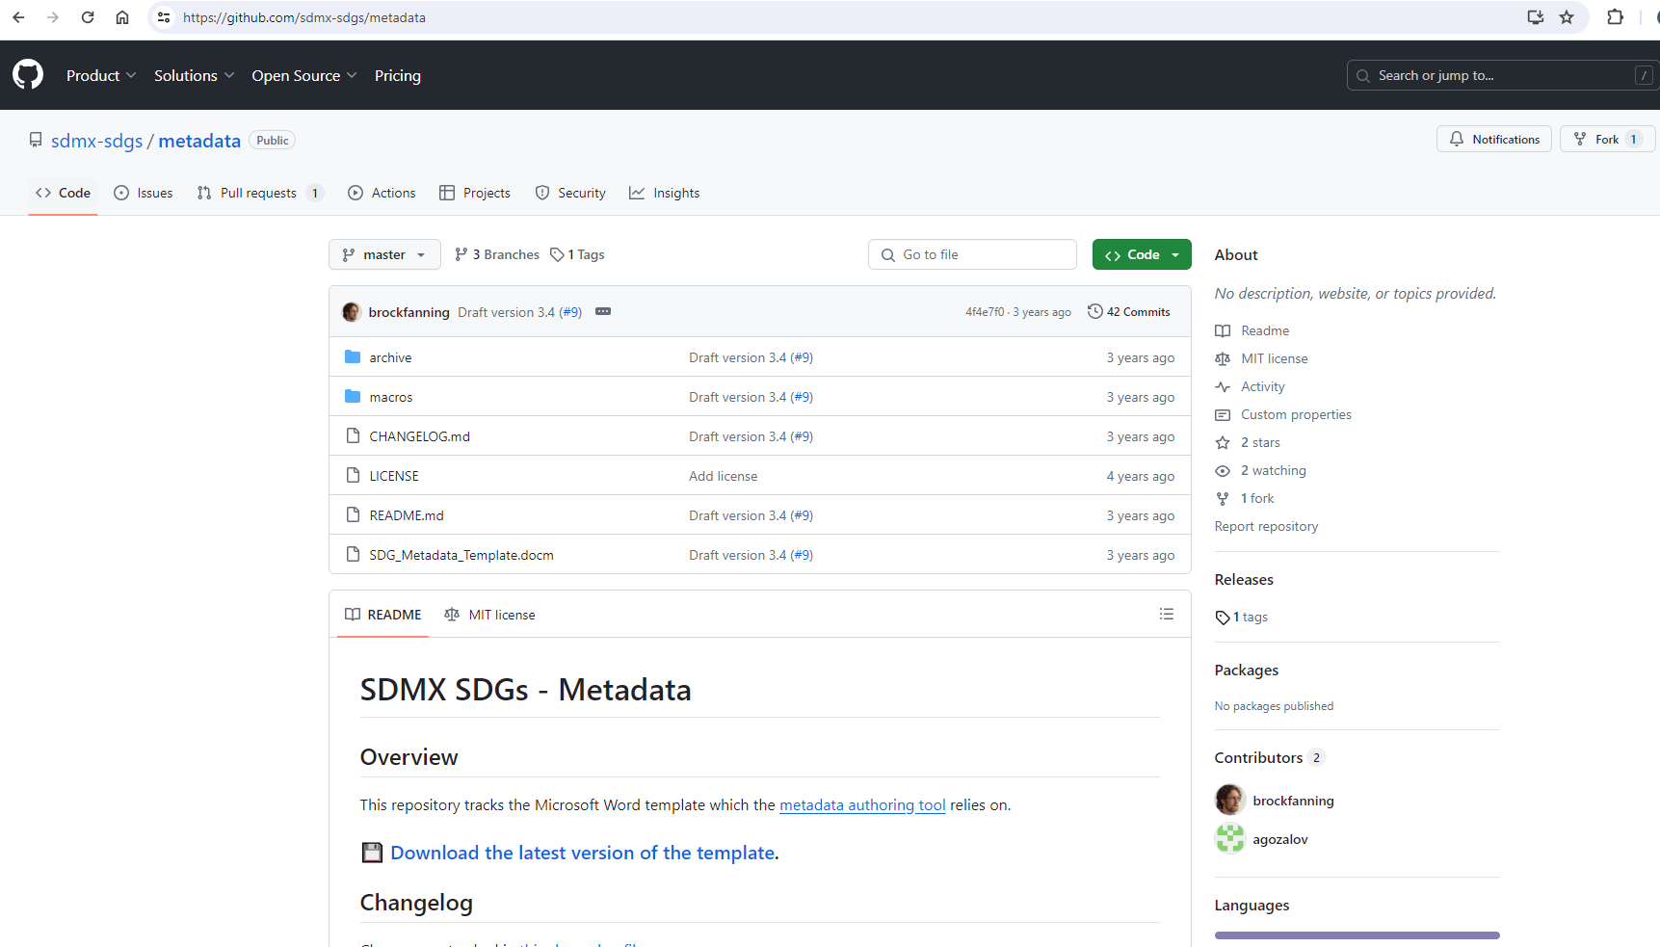
SDG metadata template
https://github.com/sdmx-sdgs/metadata
Source: Eurostat

Slide 39
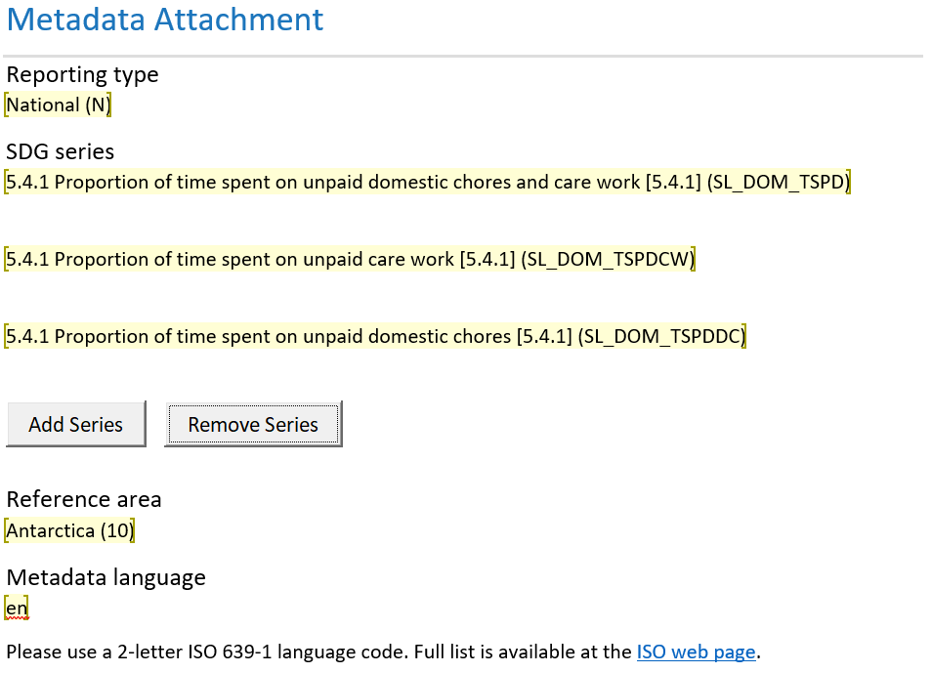
Metadata attachment
Metadata should be attached to the series, and not the indicator, because some indicators may have more than one series to which different metadata may apply.
Metadata attachment
Refers to the way in which the metadata is associated with the datasets it describes.
In SDMX for SDGs, metadata is attached based on the following parameters:
Reporting type (National, Regional, Global)
SDG series
Reference Area (Countries and areas and regions)
In addition, Language is also specified (SDMX metadata is multilingual)

Slide 40
Concepts
In the Metadata Structure Definition (MSD), the concepts describe all relevant characteristics of the metadata
SDG metadata concepts:
  0. Indicator information
  1. Data reporter
  2. Definition, concepts and classifications
  3. Data source type and data collection method
  4. Other methodological considerations
  5. Data availability and disaggregation
  6. Comparability/deviation from international standards
  7. References and documentation

Slide 41
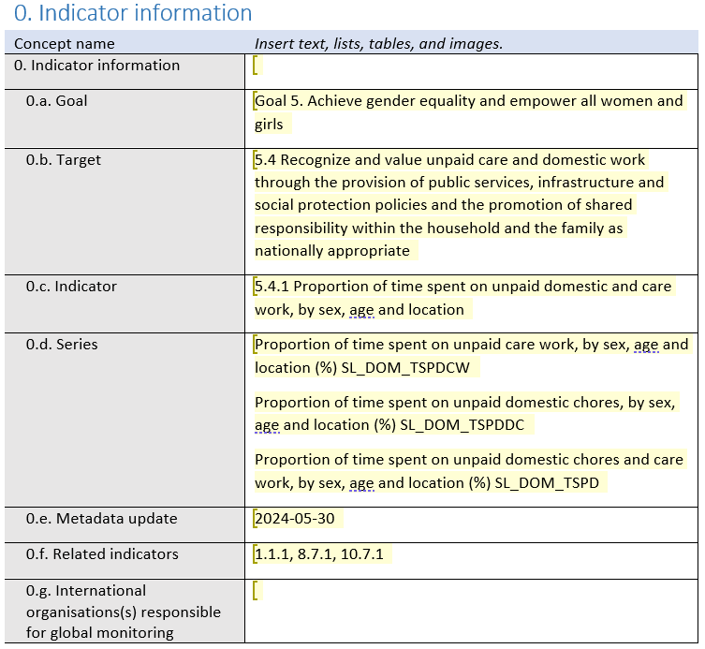
Concepts
0. Indicator information
Please fill out 0.a – 0.e as a minimum.
0.g is not applicable for national reporting and should be left blank.

Slide 42
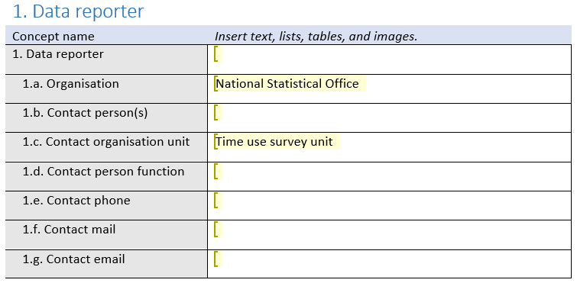
Concepts
1. Data reporter
Please fill out as much contact information as you can in 1.a – 1.g.

Slide 43
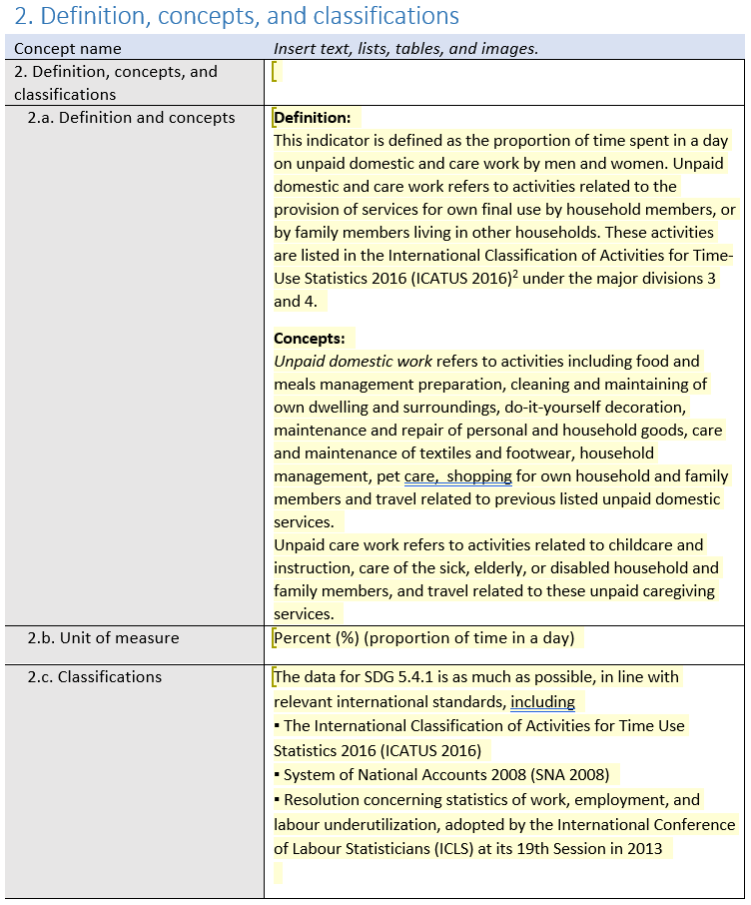
Concepts
2. Definition, concepts and classifications
You may choose to fill out only the main concept (2. Definition, concepts, and classifications) or you may choose to fill out all or some of the detailed concepts (2.a, 2.b, 2.c) separately.

Slide 44
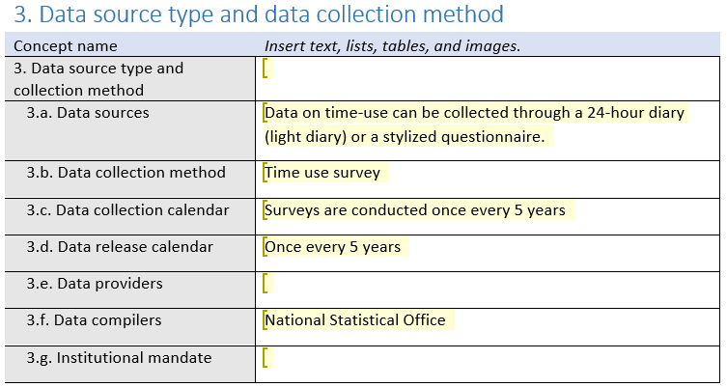
Concepts
3. Data source type and data collection method
You may choose to fill out only the main concept (3. Data source type and collection method) or you may choose to fill out all or some of the detailed concepts (3.a – 3.g) separately

Slide 45
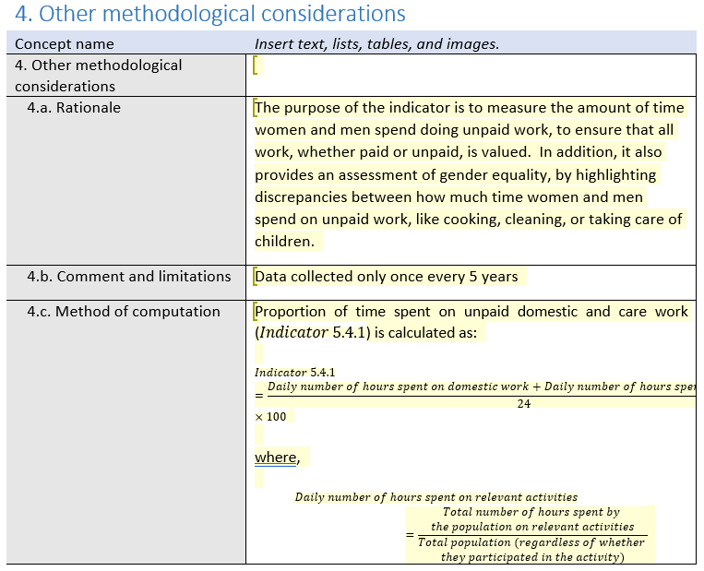
Concepts
4. Other methodological considerations
You may choose to fill out only the main concept (4. Other methodological considerations) or you may choose to fill out all or some of the detailed concepts (4.a – 4.d, 4.h – 4.k) separately. 4.e – 4.g are not relevant for national reporting and should be left blank.

Slide 46
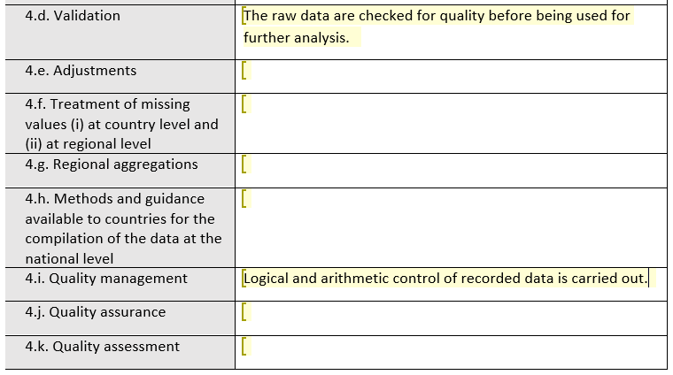
Concepts
4. Other methodological considerations
You may choose to fill out only the main concept (4. Other methodological considerations) or you may choose to fill out all or some of the detailed concepts (4.a – 4.d, 4.h – 4.k) separately. 4.e – 4.g are not relevant for national reporting and should be left blank.

Slide 47
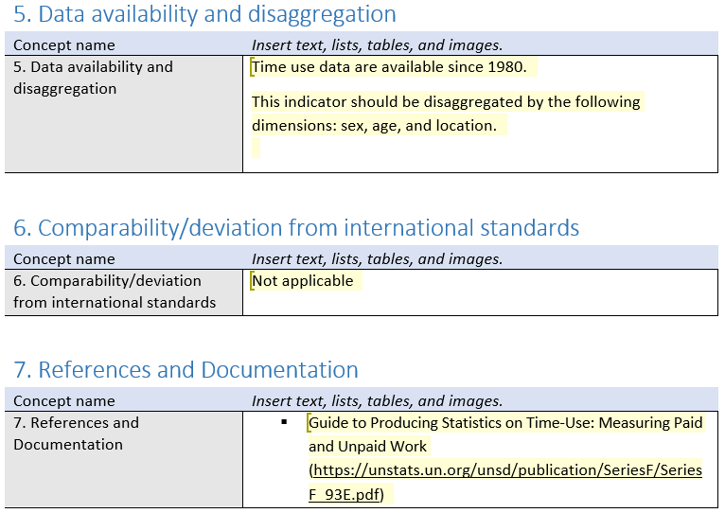
Concepts
5. Data availability and disaggregation
6. Comparability/deviation from international standards
7. References and documentation

Slide 48


Authoring SDG metadata for SDMX conversion
Requirements:
Microsoft word
Web browser

Slide 49




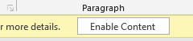
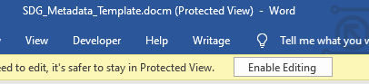
Authoring SDG metadata steps
(1) Download latest version of the metadata template
https://github.com/sdmx-sdgs/metadata/raw/master/SDG_Metadata_Template.docm
(2) Rename the file for a particular SDG indicator
(3) Open file in Microsoft Word and press “Enable editing” and “Enable content” buttons as needed.

Slide 50
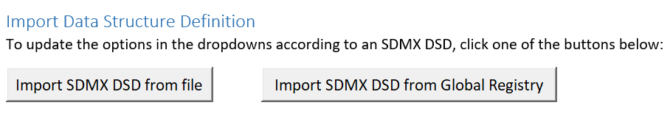
Authoring SDG metadata steps
(4) If you use a custom DSD, attach it in the “Metadata Section” with the “Import SDMX DSD” button.

Slide 51
Authoring SDG metadata steps
(5) Metadata attachment:
Select Reporting type
Select Series (for multiple series, press “add Series” button as needed)
Select Reference area
Indicate the language of your metadata

Slide 52
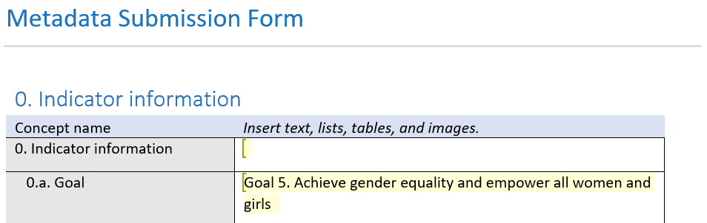
Authoring SDG metadata steps
(6) In the “Metadata Submission Form” section you will enter your metadata.
Use only the metadata concepts provided. Do not add additional metadata concepts. Only the SDMX Metadata Concepts can be read by the automation tool.
For details on what each field should contain, see the “Appendices” at the end of the document.

Slide 53
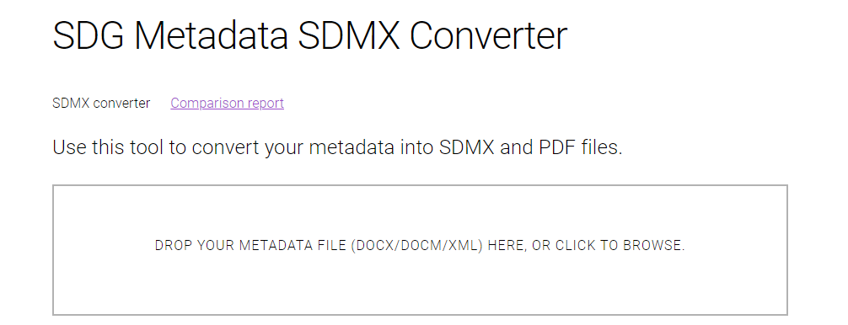
Authoring SDG metadata steps
(7) When you are finished entering the metadata, save and close the file.
(8) Open the authoring tool web app
https://sdg-metadata-sdmx.herokuapp.com
(9) Drag in or select your saved Word
file, then wait a moment for it to
process.

Slide 54

Authoring SDG metadata steps
(10) Examine the output: Your browser will automatically download a zip file, containing two versions of the metadata:
PDF version: Useful to see how exactly your metadata will be represented in the SDMX
SDMX version: This is the completed SDMX output for your metadata.
The authoring tool will show warnings if there are any problems with the Word template.
Correct any issue and convert again.

Slide 55

Rich-text features of word that can be used
Bold
Italics
Underline
Unordered lists
Ordered lists (caveat: nested numbered lists should be avoided if the numbering scheme is important. In this case, number the list manually without rich-text formatting)
Headings
Tables
Images
Footnotes
Equations

Slide 56
Rich-text features that cannot be used
Any other rich-text features apart from those listed above, such as:
Colors cannot be used (including font colors, background colors, etc.)
Shapes
Fonts

Slide 57
Recommendations for drafting and compiling metadata
• Prepare metadata that is comprehensive but not overwhelming (mandatory fields vs. describing everything)
• Use standard terminology and avoid duplication (document necessary variations from standards)
▪ Create descriptions that are easy to understand for different stakeholders
▪ Preserve historical metadata e.g. changes when methods of data production change
▪ Document workflows e.g. around ownership, approval, date of operation
▪ Create metadata in local languages where possible
▪ Include contact details - and ensure contact points are monitored

Slide 58
THANK YOU!

Slide 59
Metadata resources
Statistical Data and Metadata Exchange (SDMX)
  SDMX Glossary
  SDMX statistical guidelines on Global Metadata Structure Definition (MSD) and Concept Scheme
  SDMX statistical guidelines on Standardising Reference Metadata Reporting in SDMX
Data Documentation Initiative (DDI)

