Slide 1
Advanced SDMX Converter
Abdulla Gozalov
UNSD-ESCWA Advanced SDMX Workshop
Beirut, 27 Jun – 1 Jul 2022

Slide 2
SDMX Converter: advanced functions
SDMX Converter features and additional applications can facilitate automation and reduce the mapping effort.
Command-line application facilitates batch processing.
  Multiple datasets could be processed at a time.
SDMX Web Service and Java library can be used by software developers to create custom applications that rely on SDMX Converter functionality.
Advanced features of SDMX Converter can be used with any of the versions, i.e. Web, desktop, command line, library
  Facilitate the development of complex data entry spreadsheets
  Simplify mapping between the original data source and SDMX structures

Slide 3

Transcoding
Transcoding refers to code mapping, when internal codes are different from DSD codes.
Transcoding can be stored within data spreadsheets or in external files. This is very useful when multiple sheets need to be mapped and reused.

Slide 4
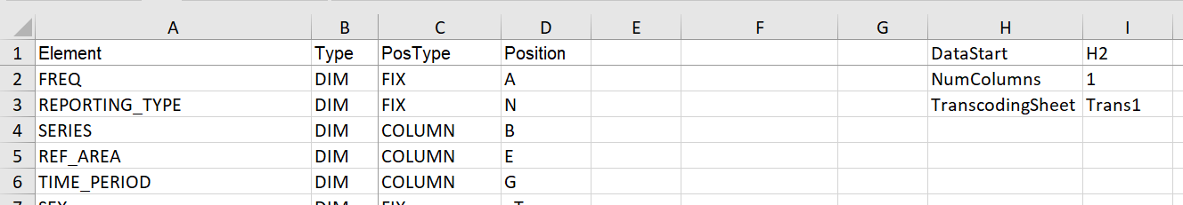
Transcoding worksheet: name
Transcoding can be supplied in a worksheet. The name of this worksheet must then be specified in Parameters.
The name of the parameter is TranscodingSheet.
This example specifies that transcoding is stored in a worksheet named Trans1. Any other valid name that starts with Trans can be used.

Slide 5
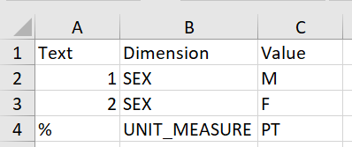
Transcoding worksheet: format
3 columns are used
  Text: original code
  Dimension: concept to which transcoding applies
  Value: DSD corresponding to the original code
During conversion, original code specified in the Text column, will be substituted with DSD code specified in the Value column for the concept specified in the Dimension column.

Slide 6
Multiple Parameter worksheets
Using a single Parameters worksheet means that all data worksheets must have the same layout.
  Concepts must be placed in the same rows/columns/cells
If worksheets in a data entry spreadsheet have different layouts (e.g. for different indicators), multiple parameter worksheets can be specified.
If multiple worksheets are used, an additional spreadsheet is required to specify which Parameter worksheets apply to which data worksheets.
A single Parameter worksheet can be used with multiple data worksheets.

Slide 7
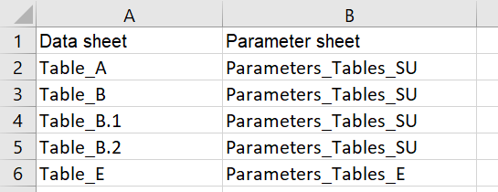
Parameter mapping
When multiple parameter worksheets are used, a worksheet named Parameter_mapping specifies the relationship between parameter and data worksheets.
Two columns are used. The Data sheet column specifies the name of the data worksheet, and the Parameter sheet column specifies the name of corresponding parameter worksheet. Worksheets for which a parameter worksheet was not specified, will not be processed.

Slide 8
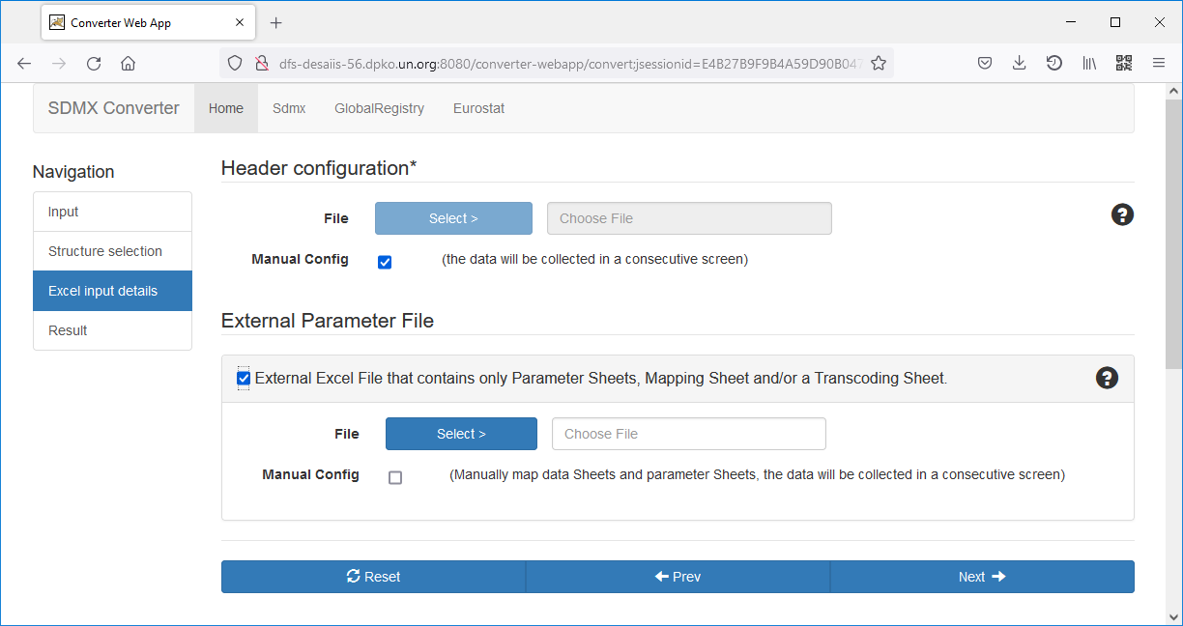
External parameters and transcoding
Parameter and transcoding sheets can be stored in external files rather than within the data spreadsheet.
During the conversion process, location of the external file with parameters and transcoding can be specified.

Slide 9
Additional Excel parameters
MaxEmptyRows – the maximum number of rows without observations after which Converter completes the processing of sheet.
DataEnd – the last (bottom right) cell with data; can be used instead of NumColumns.
MaxEmptyColumns – the maximum number of columns empty columns after which Converter moves to the next row.
SkipRows – can be used to instruct Converter to not process specified rows, e.g.
SkipRows | 24, 25, 26

Slide 10
Additional Excel parameters (2)
SkipObservationWithValue - skip observation with specified value, converter will skip and ignore this observation.
SkipIncompleteKeys – true/false; skip observations with empty or wrong concept value when value is set to true. Default value is set to true.
ConceptSeparator – character that is used to separate concepts when multiple concepts are mapped to the same cell. For example:
1. Specify separator
ConceptSeparator | ;
2. Mapping: use slash to specify position inside cell
UNIT_MEASURE | ATT | COLUMN | B/1
UNIT_MULT | ATT | COLUMN | B/2
3. Use separator in data worksheet
UNIT_MEASURE
UNIT_MULT
PT;0

Slide 11
Additional Excel parameters (3)
DefaultValue – value that will be used in the output for empty observation cells
MissingObservationCharacter – character that is used to specify that an observation is missing. DefaultValue, if set, will then be used for that observation.
roundToFit – true/false; specifies whether observations must be rounded to match the maxLength attribute in the DSD.
formatValues – controls whether and how Excel formatting is applied to cells in the output.
RoundingPrecision – specifies the number of digits to be used for rounding.

Slide 12
THANK YOU!

